Slide 1
Why Advocacy and How the Heck Do You Do It?

Slide 2
Why are you here?
IRS Rules - Don’t Freak Out!
Why Advocacy?
How do you even get started?
What is Advocacy?

Slide 3
IRS Rules for Nonprofit Lobbying
Total Budget for Exempt Purpose Expenditures | Total Lobbying Spending Limits | Total Grassroots Spending Limits
$500,000 or below | 20% | 5%
$500,000 to $1 million | $100,000 + 15% of the excess over $500,000 | $25,000 + 3.75% of excess over $500,000
$1 million to $1.5 million | $175,000 + 10% of the excess of exempt over $1 million | $43,750 + 2.5% of excess over $1 million
More than $1.5 million | $225,000 + 5% of excess over $1.5 million* | $56,250 + 1.25% of excess over $1.5 million
* There is a total cap of $1 million
Source: “ACT” by Bolder Advocacy (2018)

Slide 4
What is Advocacy?
Merriam Webster definition: The act or process of supporting a cause

Slide 5
What is Advocacy?
Direct lobbying of electeds
Grassroots organizing
Public education

Slide 6
Lobbying

Slide 7
Lobbying
A lobbyist is defined as “a person who takes part in an organized attempt to influence legislators”

Slide 8
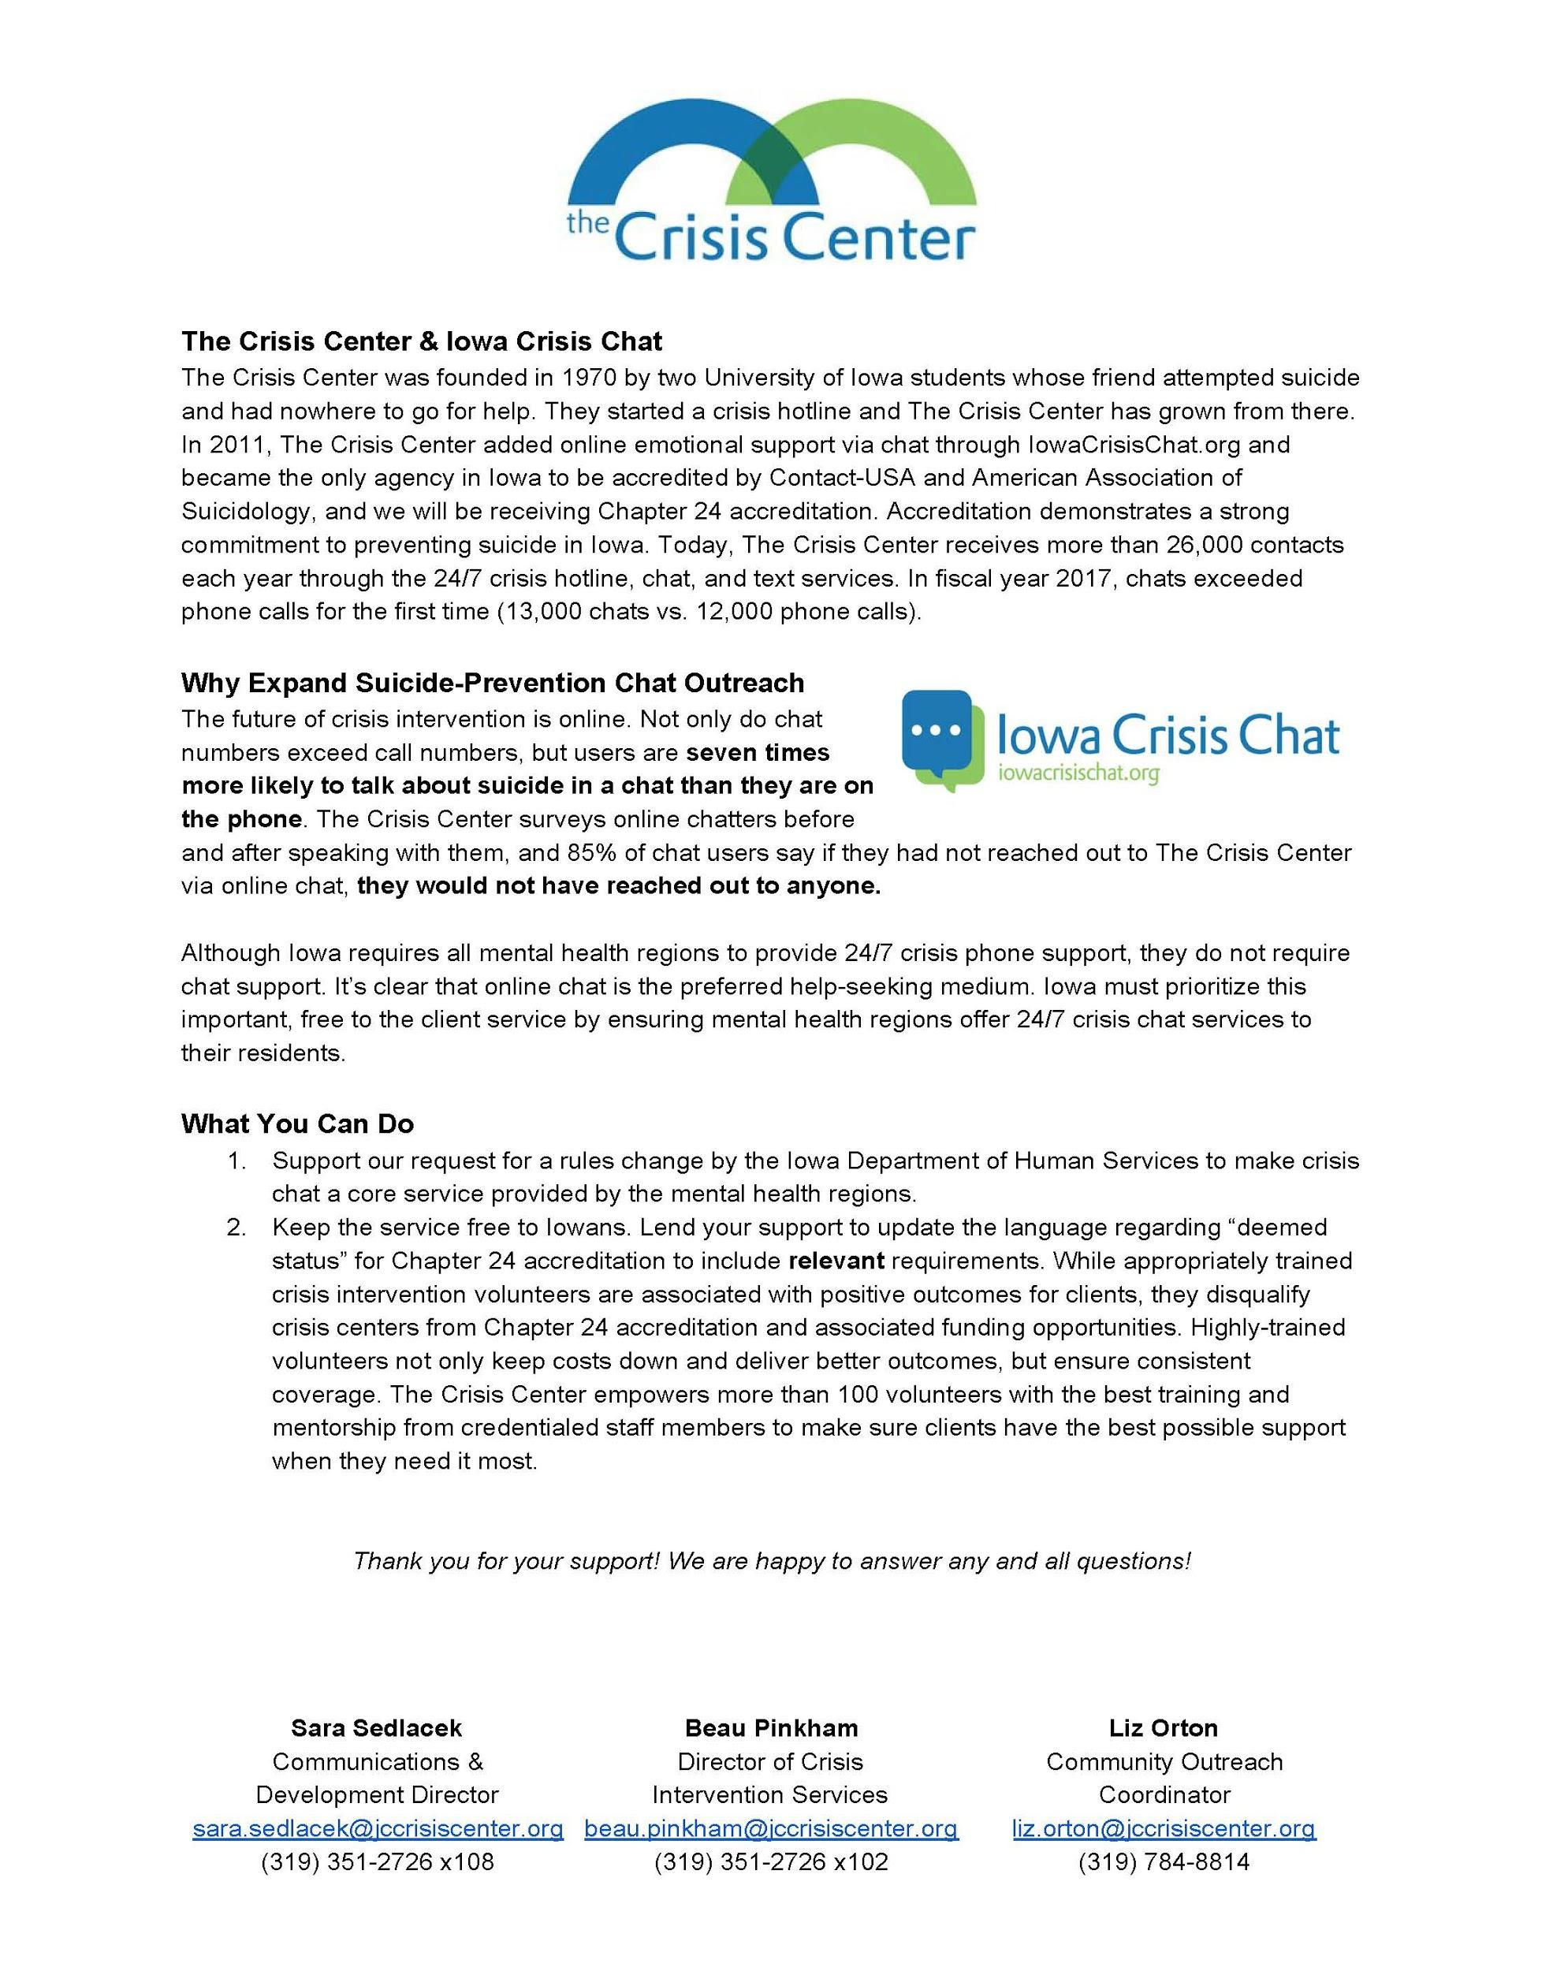
Lobbying

Slide 9
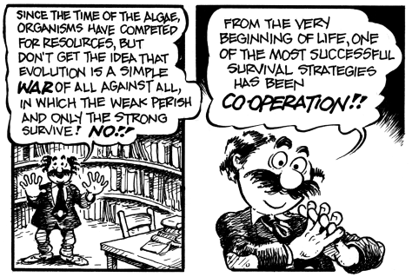
Grassroots Organizing

Slide 10
Grassroots Organizing

Slide 11
Public Education
Take advantage of earned media
Purchase social media and online ads when possible
Engage your stakeholders to be your ambassadors

Slide 12
Why is Advocacy important?
Suicide rates are up
Political climate
Pop culture
$$$ is there!
YOU are our best advocate!

Slide 13
How do you get started?
Engage your board
Decide on your issues
Develop your talking points

Slide 14
Recap
You can do this!
You don’t have to do it alone!
You have the right to talk to your elected officials!
There’s more than one way to be heard and affect change

Slide 15
Questions?

Slide 16
Contact me anytime!
Sara Sedlacek
sara.sedlacek@jccrisiscenter.org

