Slide 1
Ringing the Bell: The Power of Effective Interviewing in Crisis Centers
Notes:
Who likes doing interviews?

Slide 2
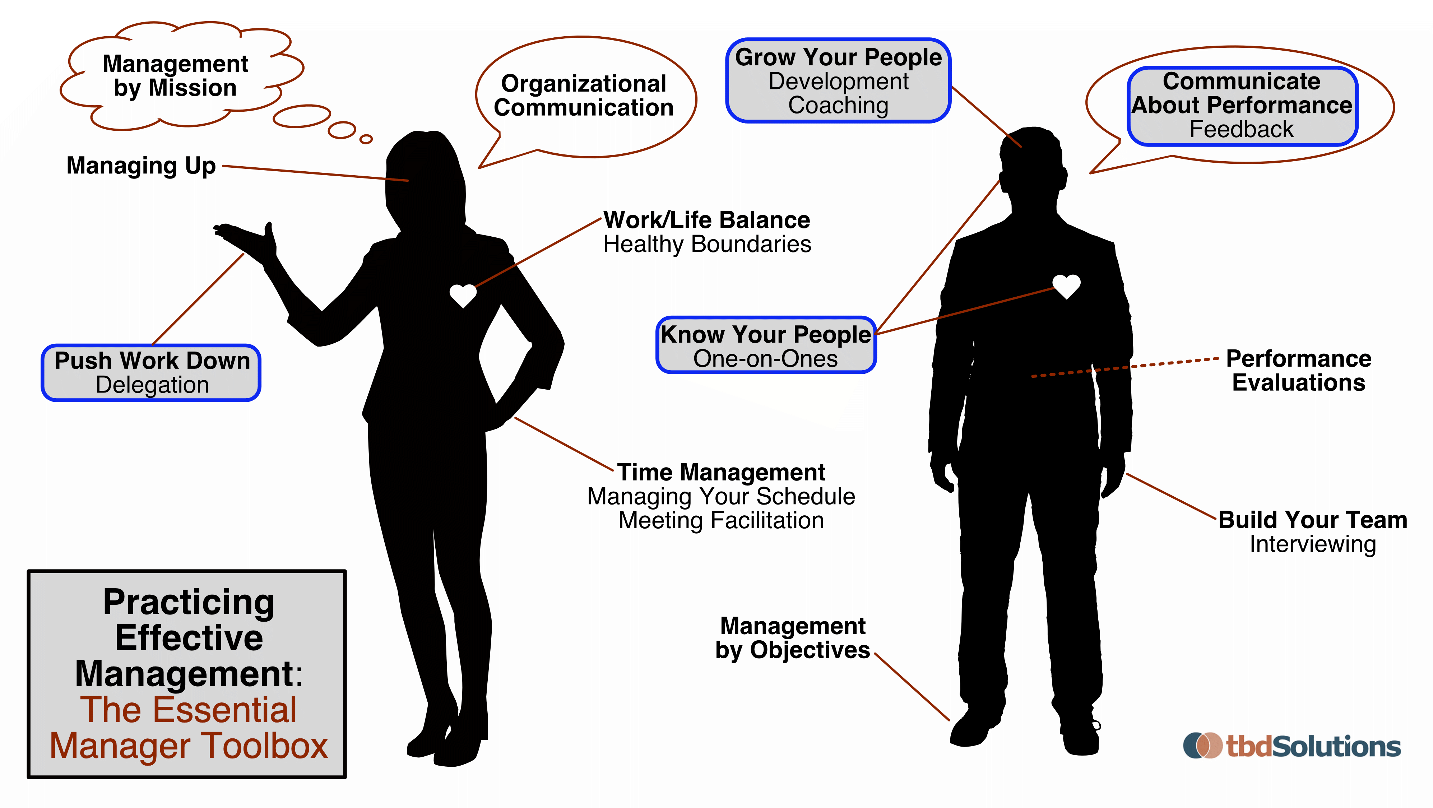
Building Your Team

Slide 3
The Importance of Hiring
Develop Relationships
Build Your Team
Notes:
Take your time to hire the right person
Which is valued more in your Talent Management/HR department—short length of time to fill a position, or hiring quality candidates regardless of the length of time?
Distorted thinking: “ANYONE would be better than NO ONE”

Slide 4
Effective Interviewing
What is the purpose of interviewing?
To hire the most qualified candidate
To hire the candidate that best fits that position
Essentially, effective interviewing is about saying “no”
Notes:
The purpose of interviewing is not “to hire the best candidate.” The purpose of interviewing is to say “no”.
Interviews, background checks, references—all are used to gather information that would determine if someone is not a good fit.
-Evaluate potential candidates
-Accurately describe the position and the organization
-Cast the best possible light on the organization

Slide 5
Effective Interviewing: Ringing the Bell
Too many managers rush to make hiring decisions
Find the candidate that is:
Qualified
Compliments the team
Has a Record of Growth (and potential for more)
Notes:
Remi to provide support?
Consider hiring candidates with tremendous potential, and be willing to hire someone with stronger skills than yourself in certain areas.
2x2 Matrix of Hire/Not Hire, Good Candidate/Bad Candidate
carnival game by Made from the Noun Project

Slide 6
The Importance of Hiring: Cost of Hiring
Task | Time | Cost
Position Requisition | 1 hour | $25
Advertising | 0.5 hours (+3 websites) | $175
Review Resumes | 2 hours | $50
Prescreen & Interview Candidates | 20 hours (1-2 people) | $600
Hiring Req | 1 hour | $25
Reference Checks | 2 hours | $50
Background Check & Drug Test |  | $100
Employee Training | 40 hours (employee time) 15 hours (trainer time) | $1375
TOTAL COST |  | $2400

Slide 7
Effective Interviewing: Three Interviews
Pre-Screen
First In-Person Interview
Second In-Person Interview
On the phone/web
1-2 behavior questions
30 minutes Maximum
45 minutes
2-3 Interviewees
Involve Peers in Panel
Notes:
When reviewing resumes, consider:
How much time was spent at each job
If a person moves frequently, is it for promotion?
Don’t presume that frequent changes are their fault (closures, moving to support family, etc.)
Be wary of job-hoppers
Would the position they are applying for be an obvious career move?

Slide 8
Effective Interviewing: Preparing to Interview
HR
YOU
Step 2
Step 1
Review Resumes
Review Job Description
Step 3
Advertisement
Score Resumes
Get Applicants
Develop Job Posting
Interview Round 1
Screens
Check Finalist References
Interview Round 2
Notes:
Remi to provide support on this slide?
There are other optional steps that your organization can opt to use if necessary.
This process should meet the needs of your organization.

Slide 9
Effective Interviewing: Three Interviews
1. Prescreen
“Tell me about yourself”
Ask 1-2 behavioral based interview questions
30 minutes max
No need to share a decision
Not In person
2. First In-Person Interview
Job description and writing prompt upon arrival prior to interview
Schedule with flexibility
45-minute interviews
3. Second In-Person Interview
2-4 interviewees
Involve peers or people who would benefit from interview experience
“Thank you for your time. If we decide to move forward in the interview process, we will contact you to schedule an interview.”
Notes:
When reviewing resumes, consider:
How much time was spent at each job
If a person moves frequently, is it for promotion?
Don’t presume that frequent changes are their fault (closures, moving to support family, etc.)
Be wary of job-hoppers
Would the position they are applying for be an obvious career move?

Slide 10
Effective Interviewing: Preparing to Interview
Location and directions
Start time and length of the interview
Interviewers
Your phone number
Send Job Description & Release of Information
Notes:
Communicate via email and be willing to follow-up with a phone call:
Planning – considerations for setting up interview:
Always have 2 people to protect against any accusations (and no more than 3-to-5 for a panel)
Make sure all interviewers are aware of limitations and responsibilities
Schedule flexibly so that you can allow for an interview to go a bit long
Communicate via email and be willing to follow-up with a phone call: Location, directions, time of the interview, length of interview, number of interviewers, your phone number, send Release of Information & JD

Slide 11
Effective Interviewing: Preparing to Interview
Interviewers
Job Description
Description of Benefits
Water
Scratch Paper
Interviewee
Notes:
Remi slide?
Room Setup
Make sure that you are in a room that meets the American’s with Disabilities Act (ADA) criteria
Free from obstruction, ease of access, etc.
Provide the following:
Comfortable chair at a table
Names of all interviewers
Copy of the job description
Description of the benefits
Scratch paper and pencil
Water and tissues

Slide 12
Effective Interviewing: Preparing to Interview
Meet with those providing interviews to:
Review candidates
Review questions
Review scoring form/criteria
Notes:
Final preparations before interviews:
Give receptionist the list of the interviewees, room locations and times, along with a way to directly contact you
Meet with those providing interviews to:
Review candidates
Review questions – and limitations
Decide who will ask which questions
Review scoring form/criteria
Reminders to represent the organization, avoiding gossip and unprofessional language, have appropriate dress

Slide 13
Developing Interview Questions and Scenarios
What skills are needed?
What does success look like in this position?
What values are important to us for this position and organization?
How coachable is the individual
Notes:
Presenter Notes: Review/discuss these questions to help develop ideas for what is important to ask an interviewee
Types of Questions
Yes/No questions can be appropriate in some circumstances, but are not preferred
Use Behavior-based questions
Example: Tell me about a time when you were falsely accused on the job, and how you resolved it.
Use Situational questions
Example: If your supervisor got sick and you had to step into their position, what’s the first thing you’d do?
Use Written questions where writing/analysis is needed
Use Test questions
Example: Typing test, language test, use of Excel, PowerPoint, etc. No personality tests pre-employment!
Identify skill sets and experiences that are critical to success in this job.
Think of current employees who are successful in their jobs. What skills do they possess that you would like to see replicated on your team?
Example categories:
Ethics/Values/Integrity
Client/Customer Focus
Emotional Intelligence/Awareness
Initiative/Motivation
Problem Solving/Decision Making
Cooperation/Teamwork/Peer Relations
Flexibility/Adaptability
Stress Management

Slide 14
Behavioral Based Interviews
Past Behavior
Future Behavior
Describe a time you…
Notes:
Remi slide?
Requests of the Candidate when scheduling interview:
Come prepared with their questions
Provide proof of credentials (transcripts, original diplomas, licenses)
Bring list of references
Bring Release(s) of Information
Past behavior is our best indicator of future behavior.
Behavioral based interview questions rely on the experiences and cognition of interviewees to provide evidence of exercised skills.
Not asking “what would you do?” but “How did you...?”
Responses to behavioral based interview questions include 3 parts
Background, Action, and Result
Example: “Walk me through a situation in which you had to adjust to changes outside of your control”

Slide 15
Behavioral Based Interviews
“Walk me through a situation in which you had to adjust to changes outside of your control”
Background
Action
Result
Notes:
Requests of the Candidate when scheduling interview:
Come prepared with their questions
Provide proof of credentials (transcripts, original diplomas, licenses)
Bring list of references
Bring Release(s) of Information
Past behavior is our best indicator of future behavior.
Behavioral based interview questions rely on the experiences and cognition of interviewees to provide evidence of exercised skills.
Not asking “what would you do?” but “How did you...?”
Responses to behavioral based interview questions include 3 parts
Background, Action, and Result
Example: “Walk me through a situation in which you had to adjust to changes outside of your control”

Slide 16
Developing Interview Questions
Situations
Behaviors
Skill Test
Tell us about a time when a manager was unavailable and you stepped in.
Tell me about a time when you disagreed with a co-worker on their approach to a project.
Excel, PowerPoint, Word, Typing test, and writing test
Notes:
Types of Questions
Yes/No questions can be appropriate in some circumstances, but are not preferred
Use Behavior-based questions
Example: Tell me about a time when you were falsely accused on the job, and how you resolved it.
Use Situational questions
Example: If your supervisor got sick and you had to step into their position, what’s the first thing you’d do?
Use Written questions where writing/analysis is needed
Use Test questions
Example: Typing test, language test, use of Excel, PowerPoint, etc. No personality tests pre-employment!
Identify skill sets and experiences that are critical to success in this job.
Think of current employees who are successful in their jobs. What skills do they possess that you would like to see replicated on your team?
Example categories:
Ethics/Values/Integrity
Client/Customer Focus
Emotional Intelligence/Awareness
Initiative/Motivation
Problem Solving/Decision Making
Cooperation/Teamwork/Peer Relations
Flexibility/Adaptability
Stress Management

Slide 17
Effective Interviewing
Education
Past Experiences
DO Ask
Career Goals
Knowledge Needed for the Position
Cultural Competency
Strengths and Weakness
Notes:
Remi slide?
Develop list of questions for the interview:
DO INCLUDE Questions about:
Past experiences
Education
Strengths and weaknesses
Knowledge needed for the position
Why they are interested in the position
Career path and goals
Cultural competency (i.e. diversity and inclusion)
Caution: Legal compliance and awareness, cannot discriminate due to religion

Slide 18
Effective Interviewing
Family/Family Needs
Race/Ethnicity
DO NOT Ask
Age
Financial Status
Martial/
Relationship Status
Notes:
DO NOT INCLUDE Questions about:
Statuses: Race, ethnicity, national origin, complexion/color, age, gender, religion, disabilities, veteran’s status, sexual orientation, bankruptcy, height, weight
Questions about family, family needs (childcare or adult care) or personal health
Avoid questions about commuting distance or location in the first interview
Avoid general chit-chat or dialog that could be construed as stereotypical or discriminatory
Financial status does not include credit history checks that can occur after release of information is signed
Age includes year graduated etc etc
Pregnant by Adrien Coquet from the Noun Project

Slide 19
Effective Interview
Subject
Address
Age
Arrests
Birthplace
Citizenship
Disability
Lawful Inquiries
Applicant’s current and prior address
Are you 18 or older?
Have you ever been convicted of a crime/felony?
Are you legally authorized to work in the US?
Ability to perform the essential functions of the job with or without accommodation?
Unlawful Inquiries
Applicant’s age or DOB
Misdemeanor arrests which did not result in conviction
Birthplace of applicant; birth certificate, baptismal records
Physical or mental conditions unrelated to the job requirements
Notes:
Remi-research for federal resources on lawful and unlawful inquiries?

Slide 20
Effective Interview: Forms

Slide 21
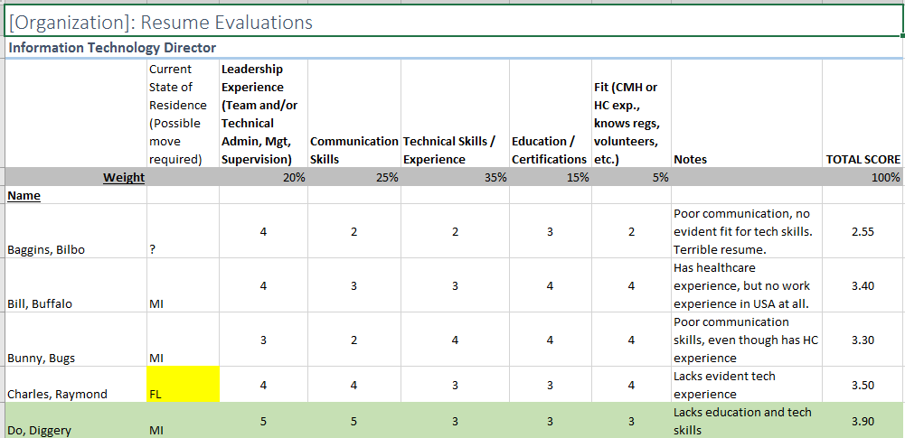
Effective Interview: Forms

Slide 22
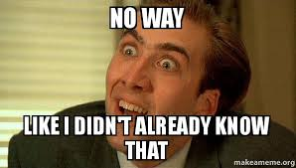

Slide 23
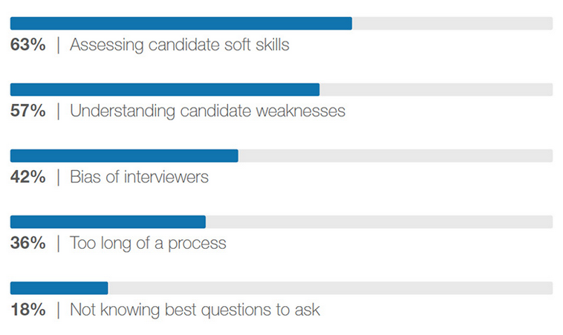
Where Traditional Interviews Fail
Notes:
Global Reporting Trends 2018 The 4 Ideas Changing How You Hire

Slide 24
New Interviewing Tools
Job auditions
Meeting in casual settings
Video Interviews
Notes:
The article mentions the four trends shaping the future of recurring and hiring – diversity (most embraced trend), new interviewing tools, data (consistent usage still isn’t widespread), and artificial intelligence (least mature trend but may be the boldest disrupter of all).
Despite their popularity, traditional interviews have been largely discredited. It’s been shown they can even undercut the impact of more useful information. Attractive and charismatic interviewees aren’t’ necessarily more capable, for example, but we unconsciously assume they are. In our survey, respondents noted the bias problem in traditional interviews as well as their limited ability to assess soft skills and weaknesses. Its hard to evaluate grit in a candidate or spot disorganization simply by having a chat.
Soft skills assessments and virtual reality assessments were also included – I removed from list as I don’t feel comfortable talking about those.
Job Auditions: In pursuit of more efficient tech hiring, Citadel became inspired by how elite institutions recruit talent. NFL coaches don’t ask prospects to describe catching a football – they watch them catch a football. So in partnership with Correlation One, Citadel designed day-long job auditions in which about 100 students compete for cash by solving real business problems with data. Recruiters watch them work in teams and use a standardized process to assess everything from how they code and think, to how they lead and collaborate. There have been over 10,000 participants to data yielding a rich pipeline of talent and dozens of hires. Impact: better ability to assess skills, more objective evaluations (measures actual performance rather than interviewing skills, past experience or former employers), positive candidate experience, stronger employer brand
Meetings in Casual Settings: better ability to see character, more relaxing candidate experience Charles Schwab’s CEI Walt Bettinger invites candidates to breakfast and asks the server to mess up their order.
Video Interview: increased hiring efficiency, more talent pool diversity, positive candidate experience

Slide 25
Alternative Tools – Let’s Practice!
Job Audition

Slide 26
Interviewing Tips: It’s Go Time
Set the candidate at ease
Review agenda
Remain focused, calm, and attentively listen
Be aware of your body language/non-verbals
Notes:
Interviewing Tips – Opening the Interview:
Welcome the candidate!
Tell them the water, scratch paper and tissues are for their use
Introduce the interviewers
Tell them that you will be taking notes during the interview
Set the candidate at ease
Ask them how their day has been, were they able to find your office easily, etc.
Review the agenda for the interview
Talk about the organization and the position
Highlight the job posting and description
Review salary range and benefits summary
Remain focused, calm and attentively listen
Be aware of your body language so that it does not give away what you’re thinking

Slide 27
Effective Interviewing: It’s Go Time
Ask them if they were able to review the job description
If not, take a few minutes now to review
Ask: “Are you able to perform the roles and responsibilities of this position with or without accommodation?”
Notes:
Ask them if they have had a chance to review the job description
If not, ask that they take a few minutes now to review
Ask: “Are you able to perform the roles and responsibilities of this position with or without accommodation?”
MUST: Ask them to sign and date the job description indicating that they are able to do the duties of the position

Slide 28
Effective Interviewing: During the Interview
Monitor the pace (x minutes/question)
Set the candidate at ease
Be aware of your body language/non-verbals
Include ALL questions
Allow for uncomfortable moments of silence
Listen for understanding – not evaluation
“I don’t know” – value transparency of the candidate
Reflect rather than disagree
Notes:
Remi Slide Sarah to provide support
It is important to have consistency between interviewees to avoid bias.
Interviewing Tips:
Be aware of the pace of the interview
Assert control if necessary
It is always best if the candidate answers ALL questions
Allow for uncomfortable moments of silence – don’t fill the gaps!
Listen for understanding – not evaluation
Respect the transparency of candidates who admit that they do not know an answer
Do not argue with an answer you disagree with
Use clarifying reflections like “What I hear you saying…”, “So you’re telling us that…”, “You feel that…”, etc.

Slide 29
Effective Interviewing: Wrapping Up Interview
Closing the Interview:
Confirm candidate’s interest
Provide timeline for next steps
Ensure the following
Date of availability to start
Request needed documents
Sign release of information
Notes:
Interviewing Tips – Closing the Interview:
Confirm the candidate is still interested in the position
Provide the timeline for next steps
Ensure the following without making it seem like a job offer:
Find out when they would be available to start
Ask for copies of needed documents (licenses, transcripts, etc.)
Get release of information (e.g. background checks, criminal record waivers, driver records, etc.)
Stand to signal the end of the interview
Offer heartfelt thanks for coming
If time allows after candidate leaves
Ensure interview scoring forms are completed & gathered
Discuss panel’s thoughts and impressions before proceeding to next interview

Slide 30
Effective Interviewing: Wrapping Up Interview
After the candidate leaves:
Review Scoring Forms
Discuss panel’s thoughts and impressions
Prep for next candidate
Notes:
Stand to signal the end of the interview
Offer heartfelt thanks for coming
If time allows after candidate leaves
Ensure interview scoring forms are completed & gathered
Discuss panel’s thoughts and impressions before proceeding to next interview
Evaluating Candidates:
Review background (e.g. criminal, education, licensing, debarment, etc.), reference checks & confirmation of past employment for final candidates
Consider candidates based on scores and evaluated criteria against what you need & person’s fit
Consider aptitude, experience and skills
Balance technical and personal strengths and weaknesses
Consider those with a lot of experience, or with good fit and too little experience (e.g. avoid age discrimination)
Ensure that you can justify your choice!

Slide 31
Effective Interviewing: Post Interview
Candidate Follow-up for Top Candidate(s) First:
Verbally offer position to top candidate
Job title, salary & benefits
Establish Start Date
Follow-up in writing with all above info
Notes:
Candidate Follow-up for Top Candidate(s) First:
Verbally offer position to top candidate
Job title
Starting salary
Benefits
Employment relationship
“At Will” vs. Bargaining Unit Agreement (Union)
Establish Start Date
Follow-up in writing with all above info
Date of drug screening/physical examination date

Slide 32
Effective Interviewing: Post Interview
Follow-up with Non-selected Candidates
For those not interviewed
Thank You
You have not been selected for an interview
For those that interviewed
Thank You
Another candidate was selected
Internal – “Why?”
External – no justifications required
Resume may be kept on file for up to 12 months
Notes:
Follow-up with Non-selected Candidates
For those not interviewed (via US mail if possible)
Thank them for applying and tell them they are not being interviewed
For those that interviewed (via email or US mail)
Thank them for their time in interviewing
Tell them another candidate was selected
Tell them that their resume may be kept on file for up to 12 months for consideration of other positions
Do not provide justifications for why someone else was selected or why the individual was not

Slide 33
Effective Interviewing: Final Reminders
Final Reminders:
You represent the organization
Have an organized, fair and open process
Avoid decisions until all interviews & background/ reference checks are complete
Notes:
Final Reminders:
YOU represent the organization!
Have an organized, fair and open process
Ensure reference checks, background checks, etc.
Avoid decisions until all interviews & background/reference checks are complete

Slide 34
Lessons Learned
Hiring Failures

Slide 35
The Essential Manager Toolbox

Slide 36
Parking Lot

Slide 37
Thank you!
Sarah Bowman SarahB@TBDSolutions.com
Remi Romanowski RemiR@TBDSolutions.com

