Slide 1
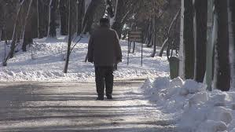
The Lethality of Loneliness
Meryl Cassidy, ACSW, LMSW
Executive Director
Response Crisis Center
Notes:
Meryl will speak about loneliness and the associated risks

Slide 2
Happy Solitude
Inner Peace and Tranquility
Grief and Loss
Heartbreak
Rejection
Homesickness
Loneliness
Social Isolation
Chronic Loneliness

Slide 3
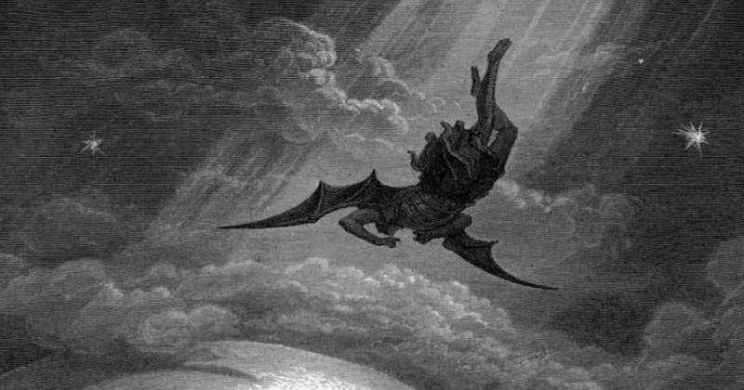
Historical Perspective
Paradise Lost – John Milton 1667

Slide 4
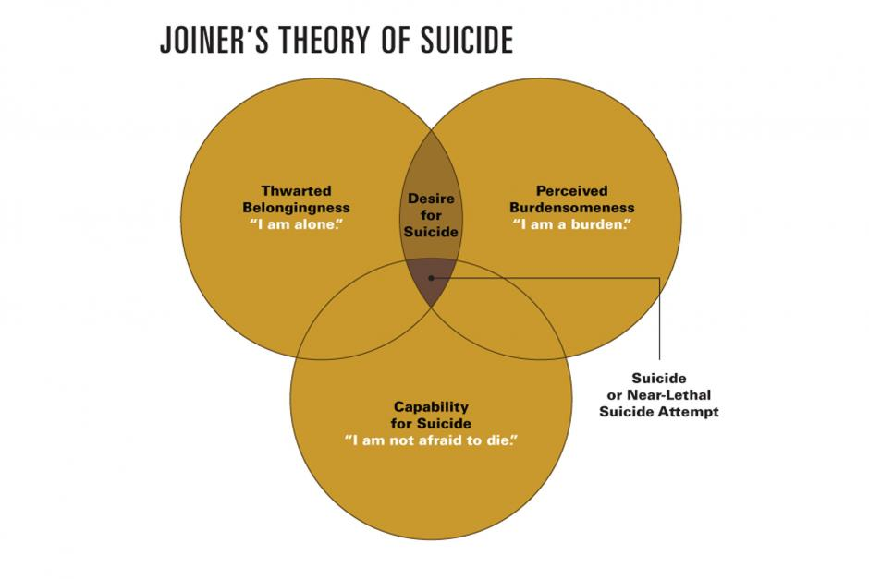
Joiner’s Interpersonal Theory
“People will be better off without me”

Slide 5
Interpersonal Needs Questionnaire
Your own current beliefs and experiences
These days the people in my life would be better off if I were gone
These days the people in my life would be happier without me
These days I think my death would be a relief to the people in my life
These days I think the people in my life wish they could be rid of me
These days I think I make things worse for the people in my life
These days, I feel like I belong
These days, I am fortunate to have many caring and supportive friends
These days, I feel disconnected from other people
These days, I often feel like an outsider in social gatherings
These days, I am close to other people
Interpersonal Needs Questionnaire-10, Adopted from “The Clinical Utility of a Brief Measure of Perceived Burdensomeness and Thwarted Belongingness for the Detection of Suicidal Military Personnel” by Bryan (2011), Journal of Clinical Psychology 67, p. 986. Copyright 2010 by Wiley Periodicals, Inc. Used with permission (see appendices F, H and I).

Slide 6
3-Step-Theory
Ideation to Action
pp
Pain-Hope Continuum

Slide 7
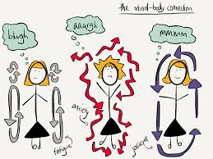
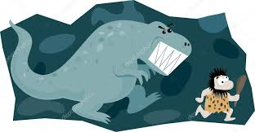
The Neurobiological Perspective on Loneliness

Slide 8
Who Are the Lonely?
Prevalence
10 million
65+
15 million
Age35-64
1 in 7
Adults in the US
live alone
More common than the nuclear family
50%
of American
adults are single

Slide 9
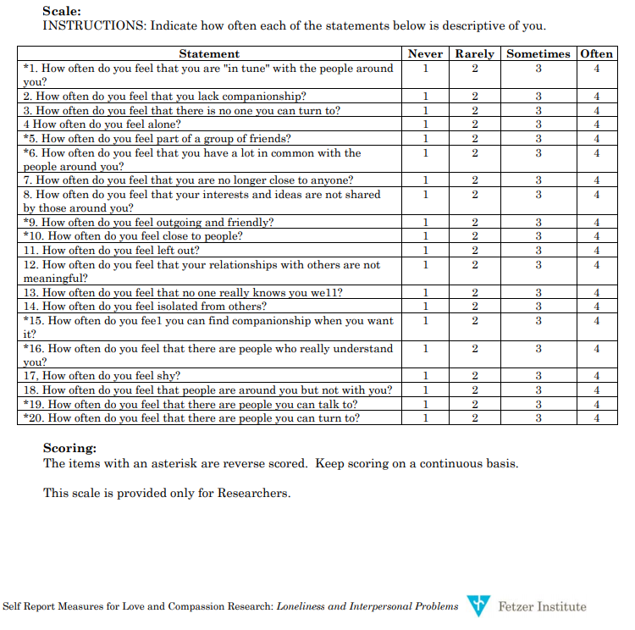
UCLA LONELINESS SCALE VERSION 3

Slide 10
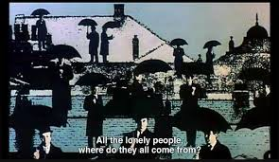
Musical Interlude
https://youtu.be/HuS5NuXRb5Y

Slide 11
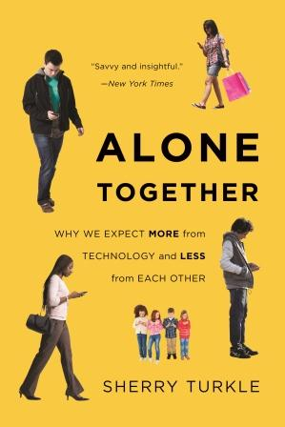
The Impact of Social Media

Slide 12
What Can We Do At An Individual Level ??
Why We All Need to Practice Emotional First Aid

Slide 13
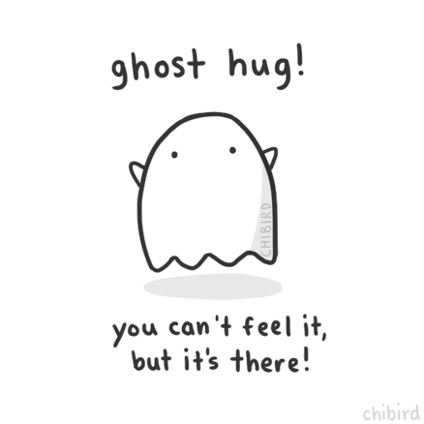
What Can We Do On The Crisis Line ?
I’m wondering if there are any people in your life that might help you feel safe? Anyone who might keep you from wanting to die?
I am so concerned about you and would like to explore ways to help you stay safe tonight
I’m wondering if there’s anything you enjoy doing for yourself? Anything that makes you feel calmer? Anything that makes you happy?
I’m wondering if you’ve thought about the possibility that things could look/feel different tomorrow?

Slide 14
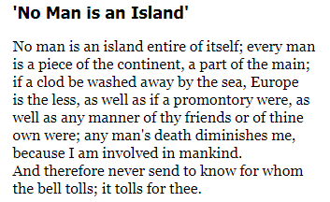
Musical Interlude
John Donne
https://youtu.be/PKY-smJ6aBQ

Slide 15
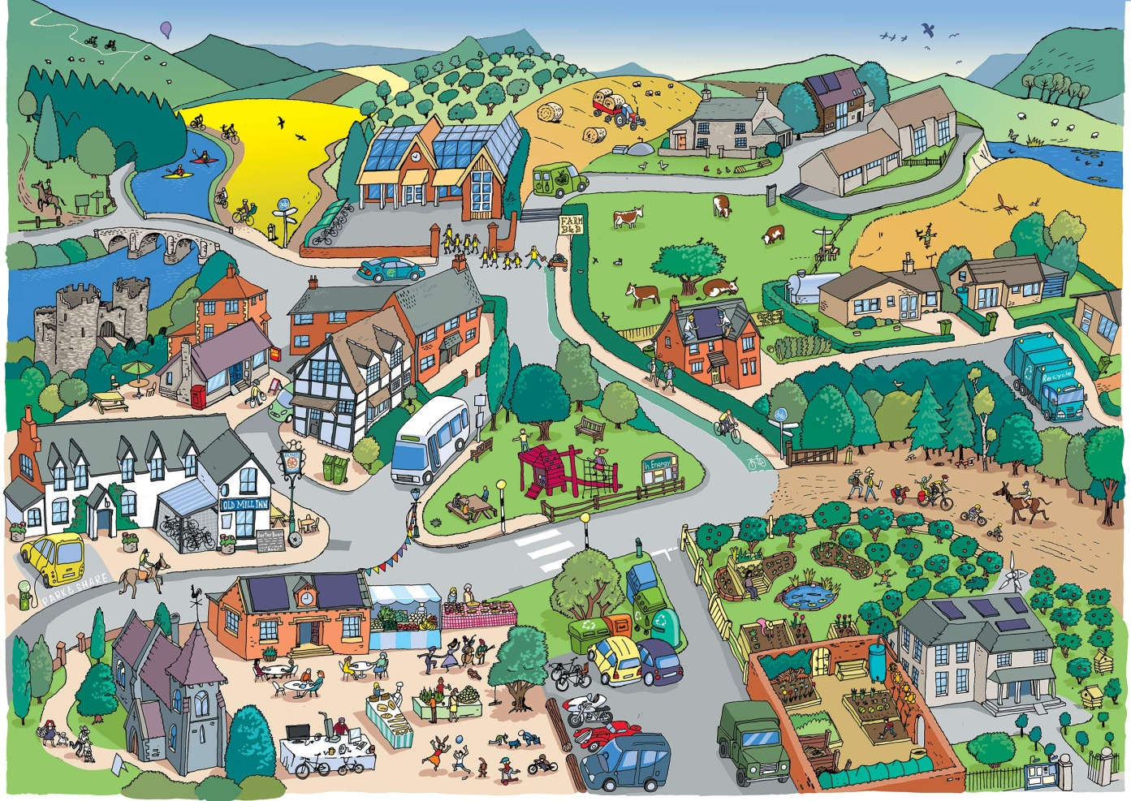
What Can We Do on a Societal Level?
The Importance of Social Infrastructure
https://youtu.be/Pm12mTIUJss

Slide 16
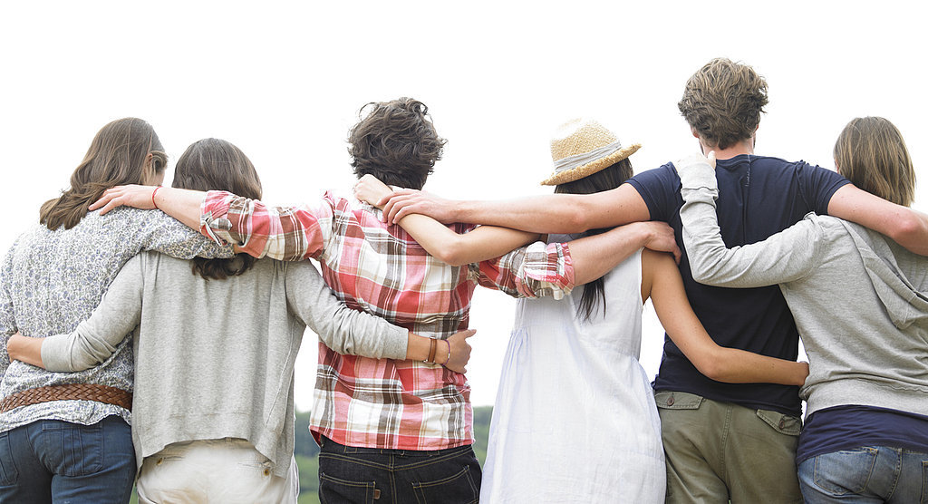
TAKE CARE OF YOURSELF AND OTHERS
Meryl Cassidy, ACSW, LMSW
Executive Director
Response Crisis Center
“As you discover what strength you can draw from your community in this world from which it stands apart, look outward as well as inward. Build bridges instead of walls. “
Justice Sonia Satomayor
https://youtu.be/53XyCbIJGKY

