Slide 1
Empathy and Evidence-Based:
Evolving your Crisis Worker Training
by: Laura Mayer, PRS CrisisLink Director
& Liz Barnes, PRS CrisisLink Trainer and Board Member
Presentation for NASCOD #CrisisCon18
Gateway to Gold: Setting the Standard

Slide 2
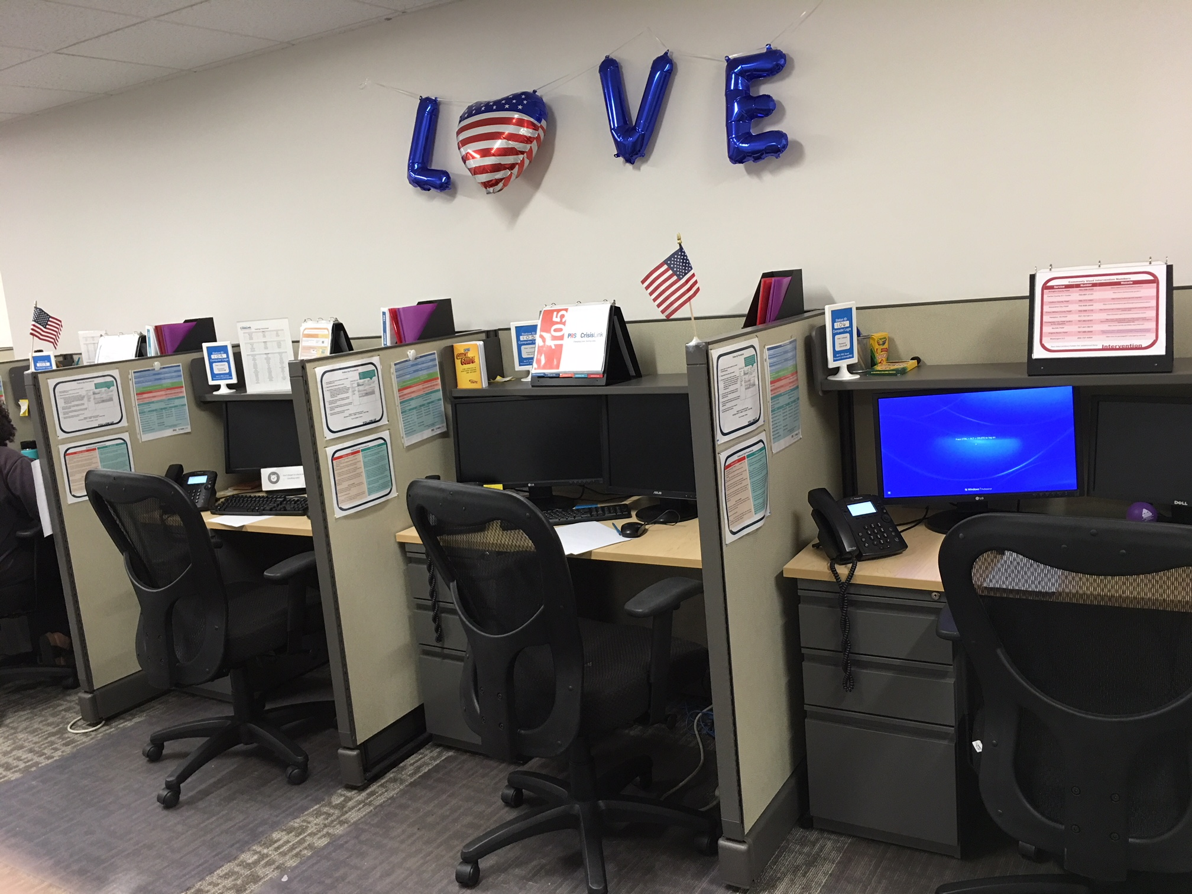
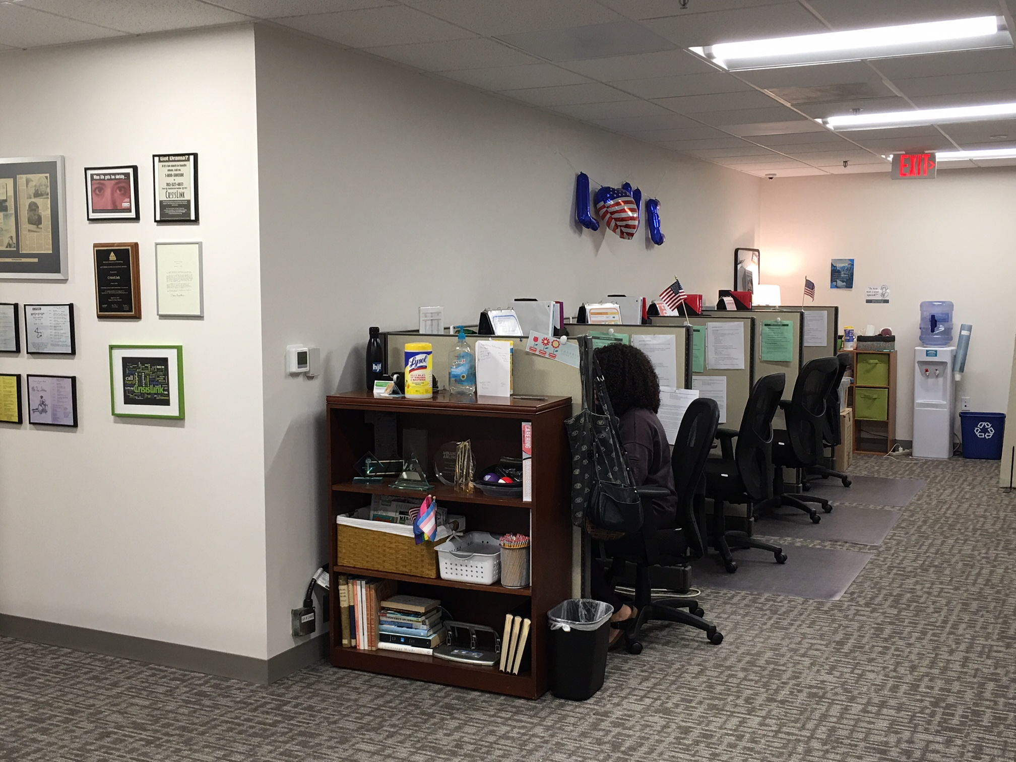
PRS CrisisLink
Notes:
Located in northern Virginia
41-45K calls handled per year
Majority Volunteer
Budget > $1 million
24/7 hotline and Textline
Offers telephone reassurance, community training, LOSS

Slide 3
#WorkshopGoals
Building or redeveloping a training program as part of Quality Control and Improvement
A structure to audit, assess and track training program needs in a planned, strategic and sustainable way
Tying training to outcomes

Slide 4
Every system is perfectly designed to get the results it is presenting presenting.

Slide 5
Training is a part of program planning, evaluation and quality control and improvement
How often do you evaluate your own training program?
Spoiler Alert:
CrisisLink did not have training as part of QI formally.

Slide 6
4 years ago…
Major organization changes
Call types were evolving and intensifying
Couldn’t make it over the volunteer hurdles
Is our training program part of our problem?

Slide 7
Accreditation
Standards
Audit of
Process
Curriculum
Adjustment
Process
Evaluation
Outcome
Evaluation
Needs Assessment
Logic Model
Monitor/ Evaluate
Implementation
Repeat
Annual Process

Slide 8
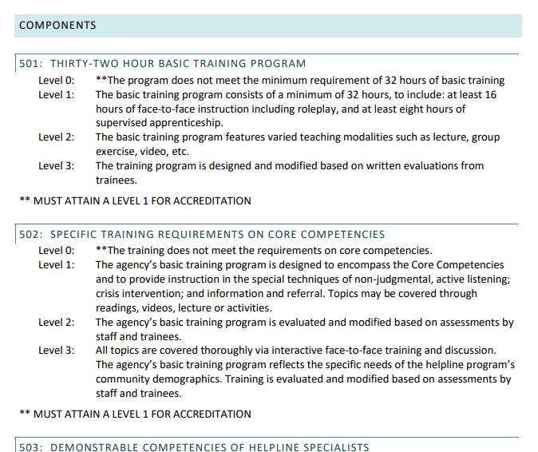
Starting Point: Accreditation Standards
ContactUSA
AAS

Slide 9
Accreditation
Standards
Audit of
Process
Curriculum
Adjustment
Process
Evaluation
Outcome
Evaluation
Repeat
Annual Process

Slide 10
Data Points We Use
Average Call Length
“Serious” Call Volume
Referral Usage
Scheduled Follow-Ups
Call Outs of Volunteers
“Could Listen Better”
Silent Monitoring
Active Rescue Totals
Volunteer Retention – Exit Surveys

Slide 11
Evaluations?
What were we measuring?
Did the evaluations tie back to competencies?
Did the evaluations address quality or knowledge or both?
Themed data from exit surveys about comfortability, stress, and overall experience (especially with early leavers)

Slide 12
What we found…
Suicide content was the most stressful for workers, with the fewest opportunities to check or confirm competency in this area.
Over prepared for serious calls; underprepared for frequent users
Models between ASIST and Call Process were different forcing the worker to lose focus
Materials were outdated and using language in consistent with the classroom

Slide 13
Our Challenges…
We were not adjusting to the types of calls received
We did not know how to measure the quality of the crisis worker
We did not have a standard process for adapting, updating, disseminating or evaluating the core training
Volunteers were finding it more difficult to come to so many sessions

Slide 14
Standardizing Empathy?
Empathy is a tool in a process that our training program cannot teach in 50 -60 hours.
This competency must be heavily screened for
Problem Solving Creativity – must have a toolbox already
Empathy was not our problem; a standard process between a variety of calls was.

Slide 15
Accreditation
Standards
Audit of
Process
Curriculum
Adjustment
Process
Evaluation
Outcome
Evaluation
Needs Assessment
Logic Model
Monitor/ Evaluate
Implementation
Repeat
Annual Process

Slide 16
Training Structure
10 Chapters in Training Manual
Chapter 1-8 had corresponding in-person, 3-hour sessions with 1 hour presentations, 2 hours of practice per session
2 On The Job Trainings (OJT) – 3 hours Each
ASIST Training 3-4 months after volunteering on the hotline
Evaluations of Crisis Workers at mid-point and through OJT trainings
This worked for a very long time with exceptional results.

Slide 17
Overhauling or Adjusting?
Training Delivery
Hybrid Training
Online Training
Maximizing Practice Time
Less subjectivity – more evaluation
Use cohesive models

Slide 18
Tried and True History
Embedded in the culture
Logically made sense
Lacked complexity
Focused far more on problem-solving, limiting the crisis worker’s understanding of the caller goals

Slide 19
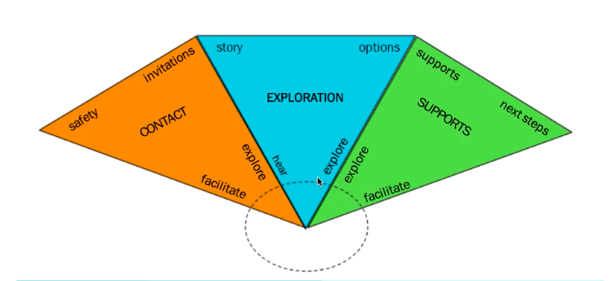
Crisis Workers are trained
In ASIST first and are always
assessing for suicide risk…
So we adapting the PAL model to a contact in which a client did not express thoughts of suicide.

Slide 20
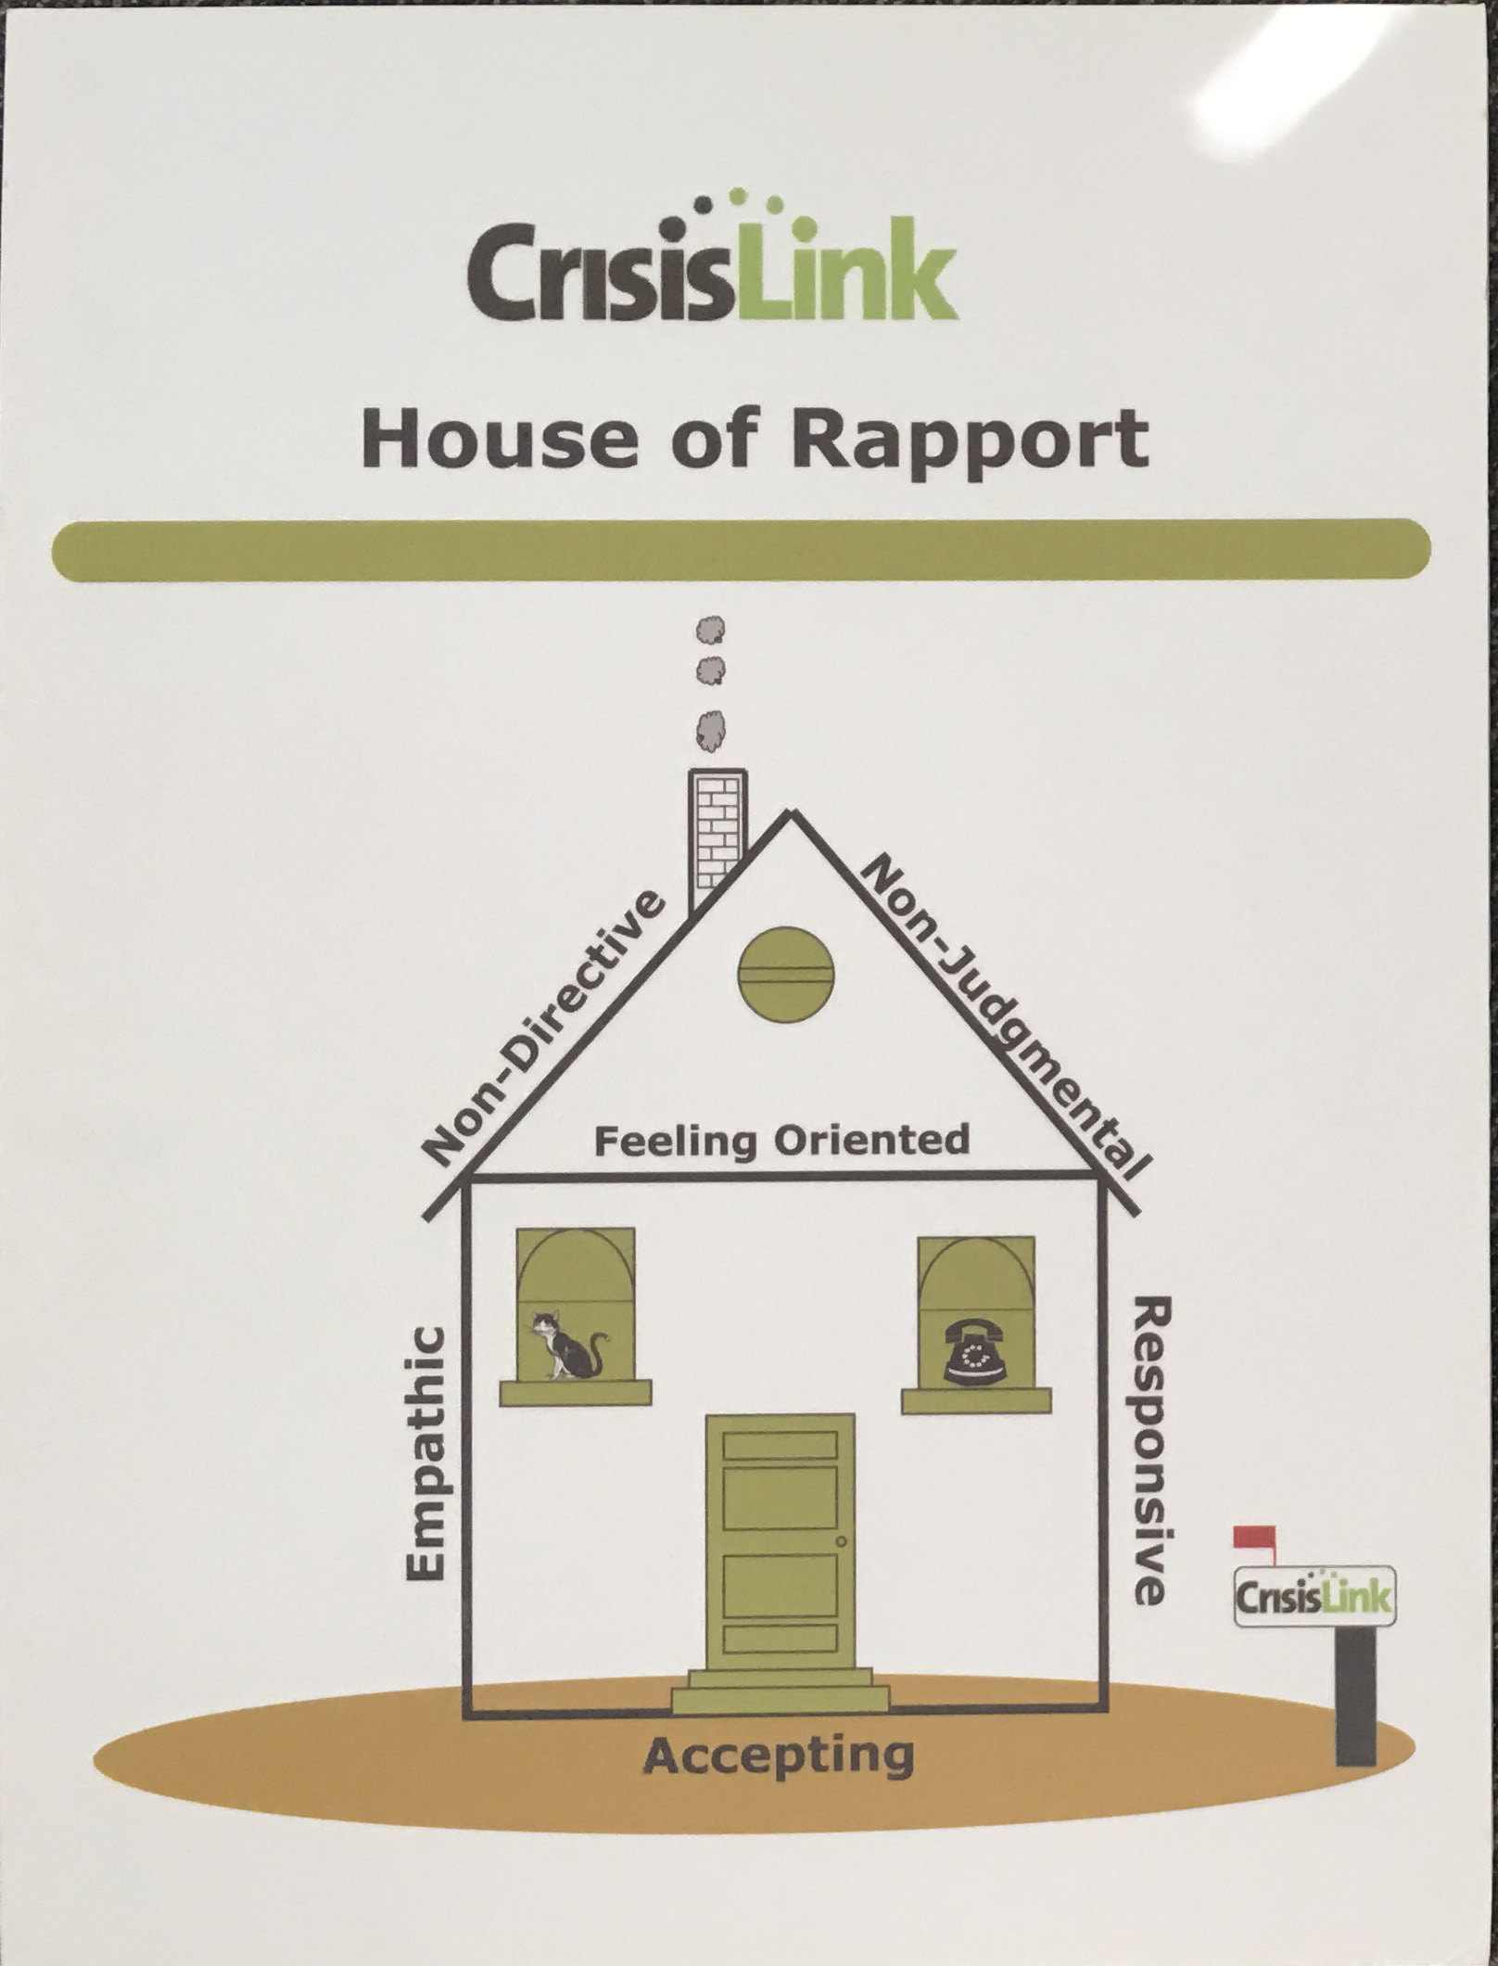
CrisisLink Philosophies
Embedded in the culture
Logically made sense
Created Safe Boundaries
Was a critical foundation for the helping role
Sometimes conflicted with the Call Process Model

Slide 21
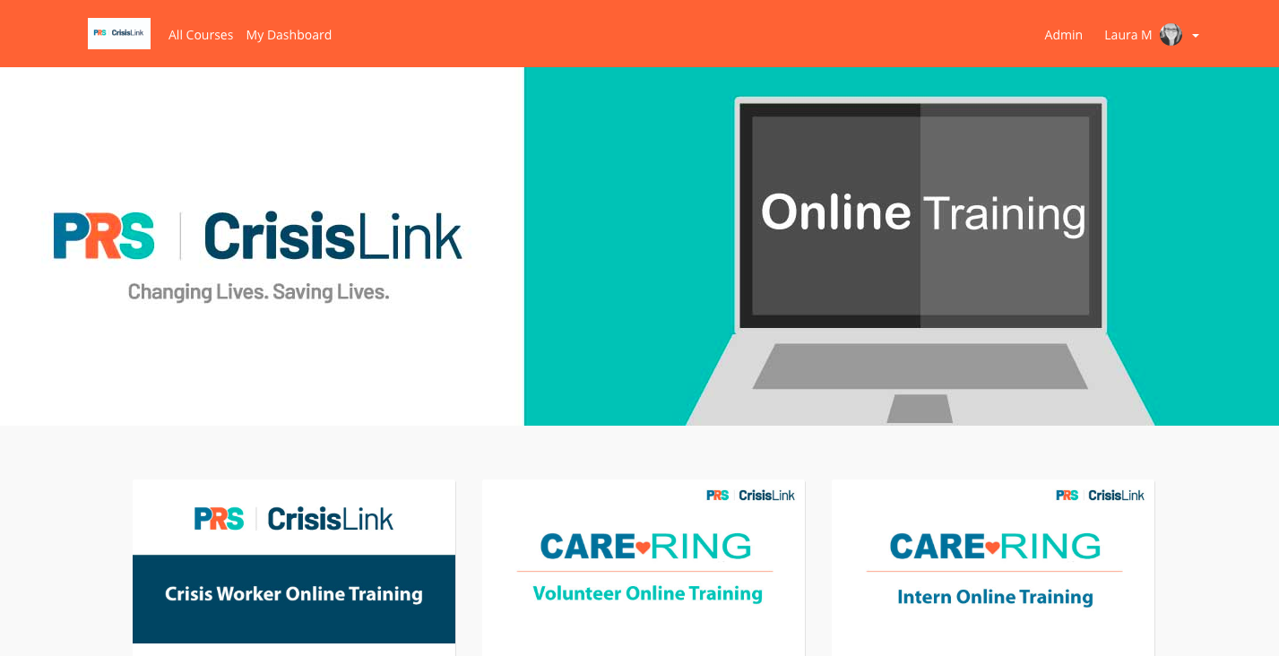

Slide 22
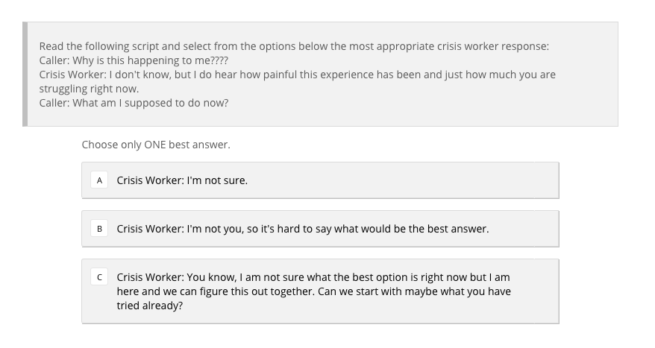

Slide 23
Recorded Role-Plays
Present several controlled role-plays
Aligned with quizzes and “choose best answer”
Evaluate responses before the next training class

Slide 24
Training Day | Curriculum/Activity
1 | Applied Suicide Intervention Skills Training Day 1
2 | Applied Suicide Intervention Skills Training Day 2
Online Training Module Welcome/Orientation
3 | Paperwork, Crisis Worker Expectations, Intro to Feelings, Intro to Helping Relationship, Intro to Active Listening (7 hours)
Online Training Modules 1-2
4 | Call Process Model, Role Plays (5 Hours)
Online Training Modules 3-4
5 | Active Rescue, Role-Plays (5 hours)
OJT1 | Reverse OJT (3 hours)
OJT2 | 1st Supervised Contact (3 hours)
OJT3 | 2nd Supervised Contact (3 hours)
41 Hours In Person
15-20 Online

Slide 25
Training Lessons Learned
Never underestimate curriculum development time
Involve your stakeholders
Culture is just as important as standardization
Use available materials
Must be a sustainable practice
Curriculum should make sense; not a check mark

Slide 26
Accreditation
Standards
Audit of
Process
Curriculum
Adjustment
Process
Evaluation
Outcome
Evaluation
Needs Assessment
Logic Model
Monitor/ Evaluate
Implementation
Repeat
Annual Process

Slide 27
Process Evaluation
Did the training delivery change how many volunteers completed the program?
Were there barriers to program completion?
Did crisis workers complete the modules on time?
How did delays with online training interact with the classroom material?

Slide 28
Process Lessons Learned
Develop sustainable practices
Reasonable expectations of volunteers
Use test subjects first before deploying to volunteers

Slide 29
Accreditation
Standards
Audit of
Process
Curriculum
Adjustment
Process
Evaluation
Outcome
Evaluation
Needs Assessment
Logic Model
Monitor/ Evaluate
Implementation
Repeat
Annual Process

Slide 30
Outcome Evaluations
On-The-Job Training Scoring Sheets
Mid and Post training scores
Adjusted and applied how we measured base-line knowledge for comparison
Surveys
Apprentice OJT Evaluation

Slide 31
Outcome Lessons Learned
Careful with cause and effect
Assessments aren’t helpful if used incorrectly
Assessments should be tied to learning objectives and competencies
Use your data

Slide 32
Outcome Evaluation - Data
Average Call Length - reduction
Referral Usage - increased
Scheduled Follow-Ups – increased for suicide, decreased for others
Call Outs of Volunteers - decreased
“Could Listen Better” - decreased
Active Rescue Totals - decreased

Slide 33
Data about center performance is also about training; as the data changes so does our training program.

Slide 34
Questions?

