Slide 1
Elevating Contact Center Operations with… Data!
Andrew Erwin and Sarah Schol

Slide 2
Agenda
Introduction to CRN
Identified Problem
Solution
Systems and Data Integration
Dashboards
Portals
Using Reporting to Improve Operations
Caseload Reports
Control Reports
Automated Reports
Notes:
Presentation description:
As healthcare networks expand - and as we expand the systems we use inside them - organizations need to leverage the opportunities to make our data "work smart" for us. This session covers the many ways Crisis Response Network utilizes technology to integrate information with CoCentrix – with external systems and applications, between departments and with other healthcare organizations. Some examples include integrating data from a telephony system, creating portals and dashboards to integrate data with partner providers, automated eligibility verification, and creating real-time reporting to streamline operations.
Outline of Presentation:
The Setup:
Introduction
CRN
Data Warehouse
Becoming an expert on each data point
Central repository of all data sources
Methods of Data Integration
API
SFTP
Data Integration with External Systems:
Multi-System Data Integration
Using API to connect data across applications – allowing one system to “talk” to another
Decreases manual data entry, human error; increases data integrity
CRN Example: ININ Bridge, GPS Trackit
Portals
Improving methods of data collection
Allows you to screen data before it’s actually received by your staff/system – can include data validation/required fields in the portal itself
Reduces employee data entry and human error
By accepting data into the data warehouse, you have options to:
Report on what is sent through the portal
Push data from the portal directly into other systems that allow data push
CRN Example: Transportation Portal, CRN Example: Terros Mobile Team SharePoint Logs – future: API for dispatch info
Eligibility Checks
Eligibility verification using a billing clearinghouse
CRN Example: SPSI and 270/271 files
Using Reporting to Streamline Operations
Caseloads
Real-time display of items needing to be addressed, cases to be handled
Essentially a “to do” list for employees, with oversight & visibility by all staff
Prevents tasks from falling through the cracks
CRN Example: Internal Dispatch Caseload, External Transportation Request Caseload
Control Reporting
Used as a way of identifying problem areas for staff – used as a training tool
Used to catch errors before they have any longer-term effects (turning up in an audit or sending bad claims)
Improvements in all departments: clinical, billing, compliance, etc.
CRN Example: Active Services with no Active Forms
Automated reporting to external parties
Increases collaboration and communication between parties
Reports – automation = decreased time staff are manually creating reports i.e. “Send a daily report to X partner listing all of their clients who had Y happen”
CRN Example: PNO Reports
Dashboards
Organized displays of information
Utilizing data to be digestible and approachable to partners, funders and internally
CRN Example: Monthly Roll-Up Dashboard, Daily Roll-up Dashboard

Slide 4
Crisis Response Network
24/7 Crisis Line
National Suicide Prevention Lifeline
24/7 Peer Support Warm Line
211 Community Info & Referral Line
Dispatch and Reporting Services
Tragedy Support Line
Police and Fire Crisis Support Line
Teen Lifeline (after hours support)

Slide 5
A Bit of Data
24/7 Crisis Contact Center
26,000 calls per month
24/7 Peer-Operated Warm Line
13,000 calls per month
Dispatch and Reporting Services
4,500 per month
Notes:
Should we link to the website at this point. We do it later, but it might be a good Segway.

Slide 6
Identified Problems
Lots of $$$ into technology, but poor ability to review, report and display data
Challenges in communication between IT, Business Intelligence (BI) and Contact Center Leadership = errors in reporting
Technology was not supporting the staff in their work
Difficulty in “telling the story” with data
Notes:
Presentation description:
As healthcare networks expand - and as we expand the systems we use inside them - organizations need to leverage the opportunities to make our data "work smart" for us. This session covers the many ways Crisis Response Network utilizes technology to integrate information with CoCentrix – with external systems and applications, between departments and with other healthcare organizations. Some examples include integrating data from a telephony system, creating portals and dashboards to integrate data with partner providers, automated eligibility verification, and creating real-time reporting to streamline operations.
Outline of Presentation:
The Setup:
Introduction
CRN
Data Warehouse
Becoming an expert on each data point
Central repository of all data sources
Methods of Data Integration
API
SFTP
Data Integration with External Systems:
Multi-System Data Integration
Using API to connect data across applications – allowing one system to “talk” to another
Decreases manual data entry, human error; increases data integrity
CRN Example: ININ Bridge, GPS Trackit
Portals
Improving methods of data collection
Allows you to screen data before it’s actually received by your staff/system – can include data validation/required fields in the portal itself
Reduces employee data entry and human error
By accepting data into the data warehouse, you have options to:
Report on what is sent through the portal
Push data from the portal directly into other systems that allow data push
CRN Example: Transportation Portal, CRN Example: Terros Mobile Team SharePoint Logs – future: API for dispatch info
Eligibility Checks
Eligibility verification using a billing clearinghouse
CRN Example: SPSI and 270/271 files
Using Reporting to Streamline Operations
Caseloads
Real-time display of items needing to be addressed, cases to be handled
Essentially a “to do” list for employees, with oversight & visibility by all staff
Prevents tasks from falling through the cracks
CRN Example: Internal Dispatch Caseload, External Transportation Request Caseload
Control Reporting
Used as a way of identifying problem areas for staff – used as a training tool
Used to catch errors before they have any longer-term effects (turning up in an audit or sending bad claims)
Improvements in all departments: clinical, billing, compliance, etc.
CRN Example: Active Services with no Active Forms
Automated reporting to external parties
Increases collaboration and communication between parties
Reports – automation = decreased time staff are manually creating reports i.e. “Send a daily report to X partner listing all of their clients who had Y happen”
CRN Example: PNO Reports
Dashboards
Organized displays of information
Utilizing data to be digestible and approachable to partners, funders and internally
CRN Example: Monthly Roll-Up Dashboard, Daily Roll-up Dashboard

Slide 7
Solutions
Brought IT Department in-house
Expanded our Business Intelligence Department
Invested in platforms/technology that allow for more effective data reporting
Built portals to replace handwritten/faxed dispatch requests
Imported client eligibility data from Clearinghouse
Automated daily reports to internal/external recipients
Added two Software Developers
Notes:
Presentation description:
As healthcare networks expand - and as we expand the systems we use inside them - organizations need to leverage the opportunities to make our data "work smart" for us. This session covers the many ways Crisis Response Network utilizes technology to integrate information with CoCentrix – with external systems and applications, between departments and with other healthcare organizations. Some examples include integrating data from a telephony system, creating portals and dashboards to integrate data with partner providers, automated eligibility verification, and creating real-time reporting to streamline operations.
Outline of Presentation:
The Setup:
Introduction
CRN
Data Warehouse
Becoming an expert on each data point
Central repository of all data sources
Methods of Data Integration
API
SFTP
Data Integration with External Systems:
Multi-System Data Integration
Using API to connect data across applications – allowing one system to “talk” to another
Decreases manual data entry, human error; increases data integrity
CRN Example: ININ Bridge, GPS Trackit
Portals
Improving methods of data collection
Allows you to screen data before it’s actually received by your staff/system – can include data validation/required fields in the portal itself
Reduces employee data entry and human error
By accepting data into the data warehouse, you have options to:
Report on what is sent through the portal
Push data from the portal directly into other systems that allow data push
CRN Example: Transportation Portal, CRN Example: Terros Mobile Team SharePoint Logs – future: API for dispatch info
Eligibility Checks
Eligibility verification using a billing clearinghouse
CRN Example: SPSI and 270/271 files
Using Reporting to Streamline Operations
Caseloads
Real-time display of items needing to be addressed, cases to be handled
Essentially a “to do” list for employees, with oversight & visibility by all staff
Prevents tasks from falling through the cracks
CRN Example: Internal Dispatch Caseload, External Transportation Request Caseload
Control Reporting
Used as a way of identifying problem areas for staff – used as a training tool
Used to catch errors before they have any longer-term effects (turning up in an audit or sending bad claims)
Improvements in all departments: clinical, billing, compliance, etc.
CRN Example: Active Services with no Active Forms
Automated reporting to external parties
Increases collaboration and communication between parties
Reports – automation = decreased time staff are manually creating reports i.e. “Send a daily report to X partner listing all of their clients who had Y happen”
CRN Example: PNO Reports
Dashboards
Organized displays of information
Utilizing data to be digestible and approachable to partners, funders and internally
CRN Example: Monthly Roll-Up Dashboard, Daily Roll-up Dashboard

Slide 8
Systems and Data Integration

Slide 9
Data Warehouse
Notes:
Once we had invested in the technical staff we began the process of assessing evaluating software, applications and partners based on their capability to access data
If we did not have the ability to freely access the data in a given system we would not use it.
This slide represents the various ways that CRN receives/consumes
Data Warehouse
Becoming an expert on each data point
Central repository of all data sources
Once all data points are stored in a single central repository, the outputs are endless:
SharePoint reports for external partners
Meaningful reports for internal departments
Control Reports
Reports that are updating every 2 seconds

Slide 10
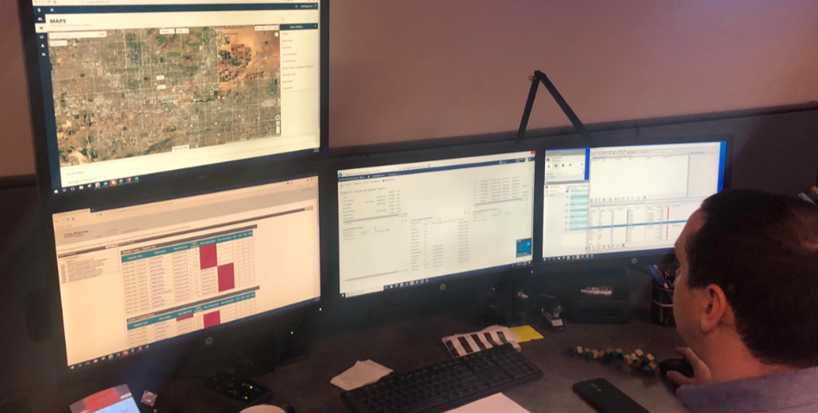
Multi-System Data Integration
Making other applications “talk” to CCP
Increase data integrity
Decrease user error
Decrease user data entry
Save time
Notes:
Data Integration with External Systems:
Multi-System Data Integration
Using API to connect data across applications – allowing one system to “talk” to another
Decreases manual data entry, human error; increases data integrity
CRN Example: ININ Bridge, GPS Trackit
API: Application Programming Interface
Method of communication between programs
Data requests happen X often, send raw data into the data source

Slide 11
Approved Client Eligibility Integration
Notes:
Manual
Crisis line staff would look up eligibility (50% error rate)
6 full time billing team staff would review and manually look up the edibility of callers
Manual process only produced a 76% data validation rate
Automation
Crisis line staff no longer review eligibility
Billing team has been reduced from 6 to 3
Our last two data validation audits received scores of 95% and 100%

Slide 12
CCX and ININ Bridge
Notes:
Should we do a demo here in the dev environment.
Manual
In order to connect our phone call records with our EHR staff had to copy a 10 digit code
Select the line of business
Start time and end times.
Automation
Recent calls automatically populate in a drop down list
Staff select the call and it fills out all the applicable fields
10 digit code plus
Line of business
Phone number
Start Time
End Time
Conclusion
Reduced thousands of errors
Gave the staff the ability to focus on the callers

Slide 13
GPS Track It
Notes:
Recap our process for dispatch
2300 MT
2000 Crisis Transports
Manual
Track teams using clothes pins
Use pieces of paper to represent clients
Use Radios to dispatch teams
Automation (2019)
Teams are Tracked on google maps
Individual information is pushed from CCX directly to the mobile teams
Dispatching happens via the app in a text format
Onscene/Clear times are all tracked automatically

Slide 14
GPS Track It/CCX Bridge

Slide 15
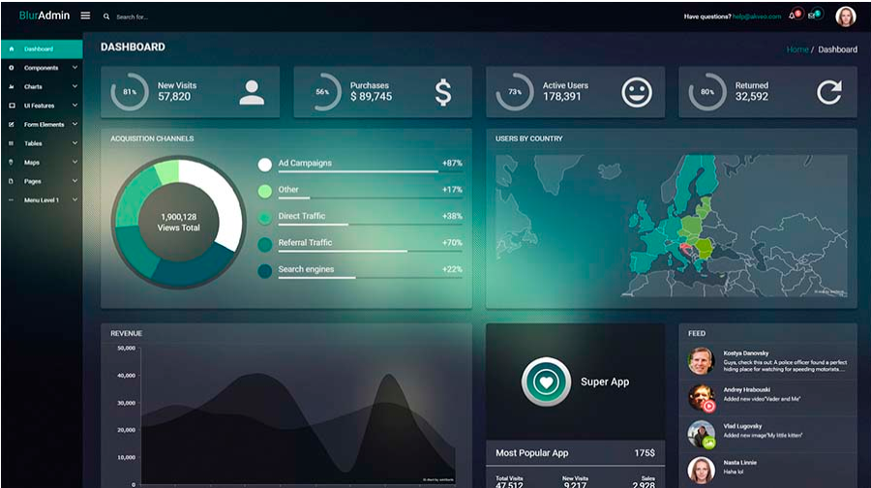
Dashboards and Portals

Slide 16
Dashboards
Letting the data tell the story
Organized, controlled information distribution
Improve data communication for:
Staff
Funders
Partners
Community
Notes:
Dashboards
Organized displays of information
Utilizing data to be digestible and approachable to partners, funders and internally
CRN Example:
- Daily Roll-up Dashboard
- CRN 600Monthly Roll-Up Dashboard

Slide 17
Contact Center Status Dashboard
Notes:
Contact Center Status Dashboard
Notes
The dashboard is fed through an API feed out of ININ
Updates every 2 seconds
Visual representation of the floor staffing
Helps supervisors manage status
Makes status of staff available to each other
Coordinate breaks
Visual representation of call queues during busy times. Turn Red

Slide 18
Contact Center Status Dashboard
Notes:
Contact Center Status Dashboard
Notes
The dashboard is fed through an API feed out of ININ
Updates every 2 seconds
Visual representation of the floor staffing
Helps supervisors manage status
Makes status of staff available to each other
Coordinate breaks
Visual representation of call queues during busy times. Turn Red

Slide 19
Abandonment Rate Dashboard
Notes:
Made this report to motive the staff and keep them focused on the metrics we care about
Daily reports are sent by email to leadership and supervisors but wanted something that the staff could see
Added in sections for total volume of individual and dispatches to remind the staff of what we do as a collective group
It is easy to take 30 to 40 hard calls on a shift and get discouraged…Talking about our collective good helps.

Slide 20
Call by Hour Dashboard
Notes:
LINK
https://crn-tableau-prod.crisisnetwork.org/#/views/CRN603-ContactCenterCallByHourDashboard_0/CRN603-ContactCenterCallByHourDashboard?:iid=1
Incredible depth of data to trend information.
Demonstration
Adjust business line to Central AZ
Show top line as trend for the month
Go over the abandonment on the right
Click on days to show the impact by day of the week. (Review of outlyers)

Slide 21
Public Facing Dashboards
Notes:
Link
https://public.tableau.com/profile/crisis.network#!/vizhome/CRN-CallStats18MonthRolling-NEWWAY/Dashboard1

Slide 22
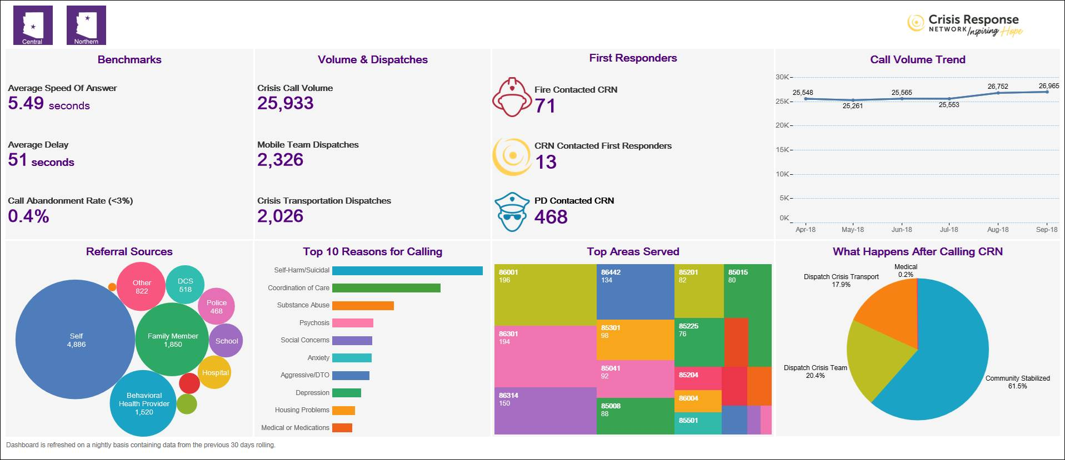
Public Facing Dashboards
Notes:
Link
LINK: https://public.tableau.com/profile/crisis.network#!/vizhome/CRN600-ContactCenterOverallDashboard/CRN600
Makes our work accessible to out community and funders.
Shows transparency about our work.\

Slide 23
Data Integration via Portal
Improve methods of data collection
Reduce employee data entry
Screen data before it enters system
Provides real time feedback to requestor
Saves time
Notes:
Disadvantages of receiving info via fax, PDF, calls:
Irregular information
Handwriting
Time to transcribe
User error in transcribing
No way of compiling data
No way of screening information before it gets to your system
Portals
Improving methods of data collection
Allows you to screen data before it’s actually received by your staff/system – can include data validation/required fields in the portal itself
Reduces employee data entry and human error
By accepting data into the data warehouse, you have options to:
Report on what is sent through the portal
Push data from the portal directly into other systems that allow data push
CRN Example: Transportation Portal, CRN Example: Terros Mobile Team SharePoint Logs – future: API for dispatch info

Slide 24
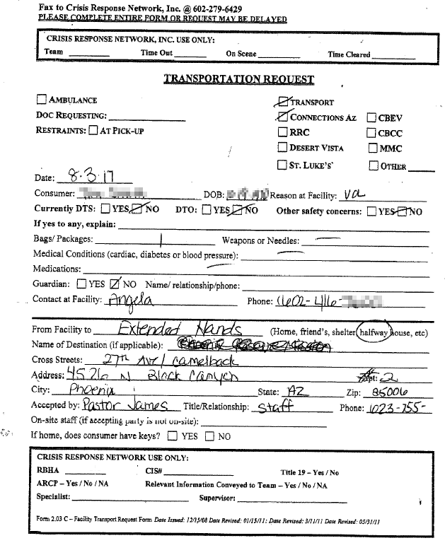
Transportation Portal
Pre- Portal, transportation requests were handwritten and faxed:
Notes:
Notes: Recap the number of Crisis Transports we do in a month.
Manual
Faxes were being sent
Follow up calls were constant. Checking on the status of dispatches.
Automation
Built a portal for the providers to fill out.
Makes sure that there is a good quality of data because it is required by the portal
Sends confirmation email that the request was received.
The data shows up in a caseload report that the provider can review for status
Data can be automatically pushed into CRN’s EHR
Conclusion
Staff can focus on dispatch
Saved time no more back and forth calls to provider agencies
Less miscommunication
CRN has the reputation as an innovative organization.
We create tools that benefit ourselves but also the community.

Slide 25
Transportation Portal
Notes:
Notes: Recap the number of Crisis Transports we do in a month.
Manual
Faxes were being sent
Follow up calls were constant. Checking on the status of dispatches.
Automation
Built a portal for the providers to fill out.
Makes sure that there is a good quality of data because it is required by the portal
Sends confirmation email that the request was received.
The data shows up in a caseload report that the provider can review for status
Data can be automatically pushed into CRN’s EHR
Conclusion
Staff can focus on dispatch
Saved time no more back and forth calls to provider agencies
Less miscommunication
CRN has the reputation as an innovative organization.
We create tools that benefit ourselves but also the community.

Slide 26
Transportation Portal
Notes:
Notes: Recap the number of Crisis Transports we do in a month.
Manual
Faxes were being sent
Follow up calls were constant. Checking on the status of dispatches.
Automation
Built a portal for the providers to fill out.
Makes sure that there is a good quality of data because it is required by the portal
Sends confirmation email that the request was received.
The data shows up in a caseload report that the provider can review for status
Data can be automatically pushed into CRN’s EHR
Conclusion
Staff can focus on dispatch
Saved time no more back and forth calls to provider agencies
Less miscommunication
CRN has the reputation as an innovative organization.
We create tools that benefit ourselves but also the community.

Slide 27
Transportation Portal
Notes:
Notes: Recap the number of Crisis Transports we do in a month.
Manual
Faxes were being sent
Follow up calls were constant. Checking on the status of dispatches.
Automation
Built a portal for the providers to fill out.
Makes sure that there is a good quality of data because it is required by the portal
Sends confirmation email that the request was received.
The data shows up in a caseload report that the provider can review for status
Data can be automatically pushed into CRN’s EHR
Conclusion
Staff can focus on dispatch
Saved time no more back and forth calls to provider agencies
Less miscommunication
CRN has the reputation as an innovative organization.
We create tools that benefit ourselves but also the community.

Slide 28
Using Reporting to Improve Operations
Notes:
Using Reporting to Streamline Operations
Caseloads
Real-time display of items needing to be addressed, cases to be handled
Essentially a “to do” list for employees, with oversight & visibility by all staff
Prevents tasks from falling through the cracks
CRN Example: Internal Dispatch Caseload, External Transportation Request Caseload
Control Reporting
Used as a way of identifying problem areas for staff – used as a training tool
Used to catch errors before they have any longer-term effects (turning up in an audit or sending bad claims)
Improvements in all departments: clinical, billing, compliance, etc.
CRN Example: Active Services with no Active Forms
Automated reporting to external parties
Increases collaboration and communication between parties
Reports – automation = decreased time staff are manually creating reports i.e. “Send a daily report to X partner listing all of their clients who had Y happen”
CRN Example: PNO Reports
Dashboards
Organized displays of information
Utilizing data to be digestible and approachable to partners, funders and internally
CRN Example: Monthly Roll-Up Dashboard, Daily Roll-up Dashboard

Slide 29
Dispatch Caseload Reports
Notes:
Demo:
Dispatch Caseload
Transportation Request Caseload
Caseloads
Real-time display of items needing to be addressed, cases to be handled
Essentially a “to do” list for employees, with oversight & visibility by all staff
Prevents tasks from falling through the cracks
CRN Example: Internal Dispatch Caseload, External Transportation Request Caseload

Slide 30
Dispatch Caseload Reports

Slide 31
Control Reports
Notes:
Control Reporting
Used as a way of identifying problem areas for staff – used as a training tool
Used to catch errors before they have any longer-term effects (turning up in an audit or sending bad claims)
Improvements in all departments: clinical, billing, compliance, etc.
CRN Example: Active Services with no Active Forms

Slide 32
Supervisor Review for Supervision
Notes:
Control Reporting
Used as a way of identifying problem areas for staff – used as a training tool
Used to catch errors before they have any longer-term effects (turning up in an audit or sending bad claims)
Improvements in all departments: clinical, billing, compliance, etc.
CRN Example: Active Services with no Active Forms

Slide 33
Automated Reporting to External Parties: Emailed Reports
Notes:
Automated reporting to external parties
Increases collaboration and communication between parties
Reports – automation = decreased time staff are manually creating reports i.e. “Send a daily report to X partner listing all of their clients who had Y happen”
CRN Example: PNO Reports, Mobile Teams

Slide 34
Automated Reporting to External Parties: SharePoint Logs
Notes:
Automated reporting to external parties
Increases collaboration and communication between parties
Reports – automation = decreased time staff are manually creating reports i.e. “Send a daily report to X partner listing all of their clients who had Y happen”
CRN Example: PNO Reports, Mobile Teams

Slide 35
Questions and Answers

Slide 36
Andrew Erwin
Sarah Schol
Chief Operating Officer
Andrew.Erwin@CrisisNetwork.org
Senior Director, Contact Center Operations
Sarah.Schol@CrisisNetwork.org
Notes:
Revisit your takeaways and thank them for coming!

