Slide 1
Activating Hope: Identifying and Implementing Best Practices for Positive Engagement of Lived Experience at Crisis Centers
DeQuincy A. Lezine, Ph.D., Eduardo Vega, M.A., & Greg Borders, LCSW

Slide 2
Part 1 - Overview

Slide 3
What is “lived experience”?
"lived experience with suicide" or "lived experience" means that a person has endured periods of suicidal intensity, distress, or has attempted suicide in the past.
Most guidance also applicable to engaging persons who know someone who died by suicide (i.e., suicide loss survivors).

Slide 4
Background – National Strategy
Objective 10.3
Engage suicide attempt survivors in suicide prevention planning, including support services, treatment, community suicide prevention education, and the development of guidelines and protocols for suicide attempt survivor support groups.
http://actionallianceforsuicideprevention.org/NSSP

Slide 5
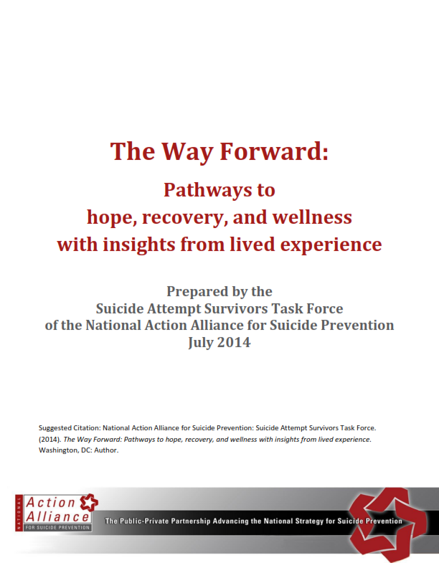
Background – The Way Forward
Pivotal report provides recommendations for advancing goals of NSSP based on the experience and expertise of suicide attempt survivors.
Core Values
Inspire hope, meaning and purpose
Preserve dignity, counter stigma, stereotypes, discrimination
Promote community connectedness
http://actionallianceforsuicideprevention.org/task-force/ suicide-attempt-survivors

Slide 6
Lifeline survey (2014): Centers with “open” attempt survivors?
Response: 91/159 centers (103 surveys)

Slide 7
Benefits to “open” attempt survivors
Greater understanding, insight, empathy
Connect better with callers
Combat stigma / promote hope or belief in recovery
Knowledge and experience with local services
Help the agency in unique ways
Must be healthy and in a good state of recovery

Slide 8
Challenges to “open” attempt survivors
How do you assess a person’s readiness to be involved?
Might over-identify with caller
Potential to be triggered by calls
Bias or limits to recommendations provided to callers
Trying to balance sensitivity to person’s needs with needs of the center
Difficult staff relations / confidentiality vs disclosure

Slide 9
Comments / What would help?
Interested and willing to get involved
Generally looking for guidance:
Identifying or finding persons with lived experience
Assessing readiness
Guidance about the disclosure process
Balancing individual needs vs center needs
Working through “triggering” scenarios

Slide 10
Activating Hope Project Partners
National Suicide Prevention Lifeline
RI International
Prevention Communities
Red Lever Innovations
SAMHSA (Grant Funding)

Slide 11
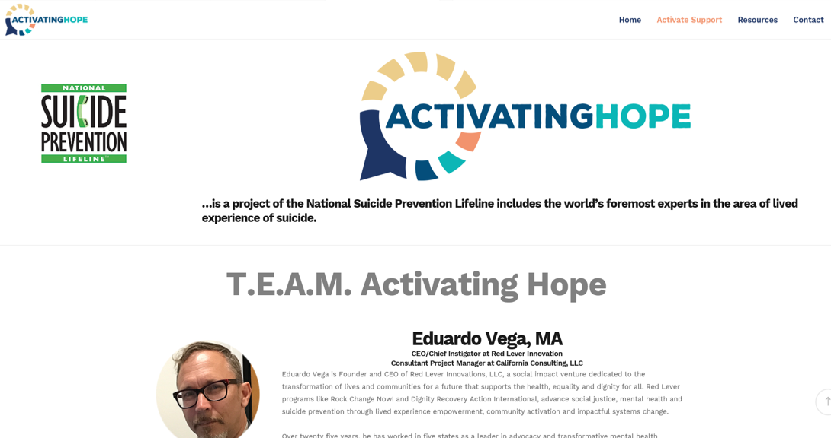
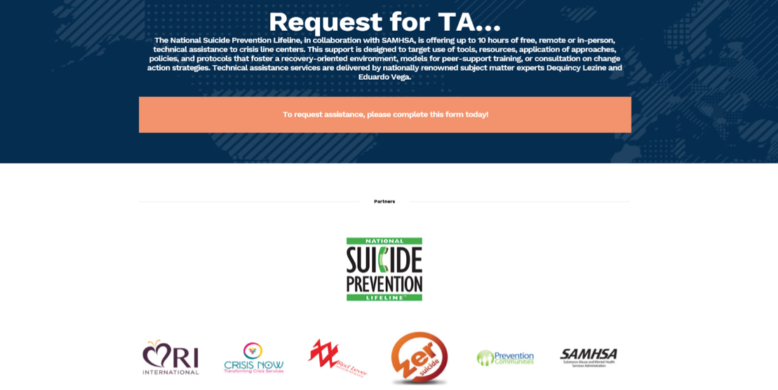
www.activatinghope.com

Slide 12
Readiness for engagement
Individual Readiness
Organizational Readiness
Personal preparation for contributing to suicide prevention
Balance between potential benefits at multiple levels vs personal costs
Varies from identifying personal experiences related to suicide to sharing specific details.
Guide for people considering involvement in suicide prevention programs.
The preparation of organizations and agencies is organizational capacity building or culture change.
Balance between potential benefits and challenges in organizational capacity
Establishing policies, procedures, resources, and attitudes to.
Guide for organizations and agencies seeking to effectively have positive engagement

Slide 13
Part 2 – Individual fit and readiness

Slide 14
Individual Readiness
Personal considerations
Practical guidance
Potential benefits and possible negative outcomes for involvement
Specific attention to type and degree of disclosure
Weighing goals and priorities in relation to involvement
Types of suicide prevention activities to consider
Specific experience, training, or preparation that might be required
Degree of confidentiality or personal disclosure that might be called for
Notes:
Are there open (disclosed) suicide loss survivors in your organization?
Yes, including leadership role(s)
Yes
I don’t know
No

Slide 15
Considerations for Personal Disclosure
Demonstration for systematic consideration of pros and cons related to personal disclosure.
Worksheet #1

Slide 16
Part 2 – Organizational Readiness and Change Process

Slide 17
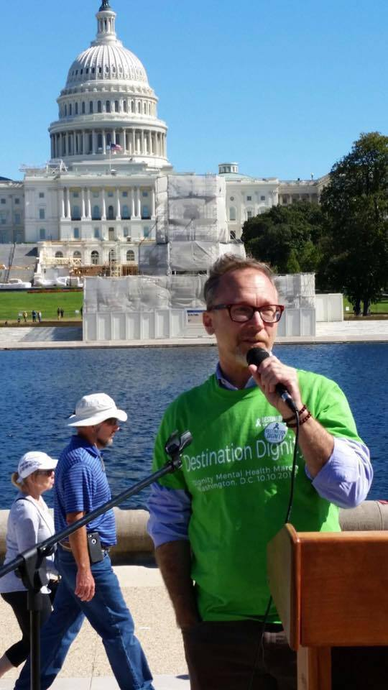
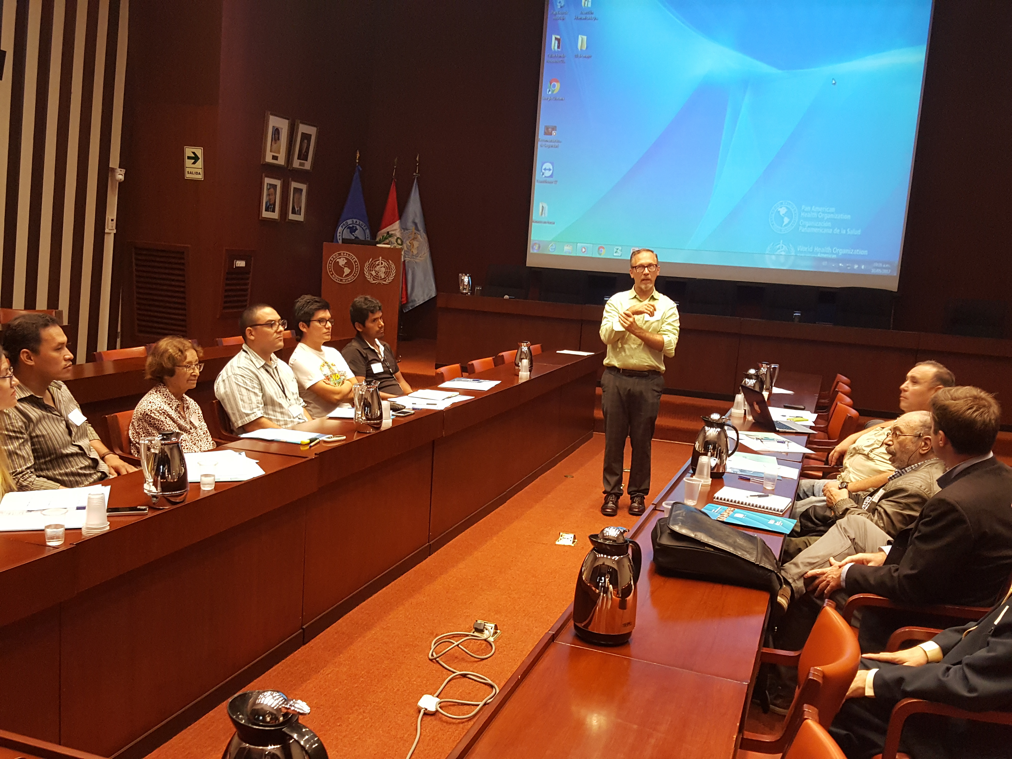
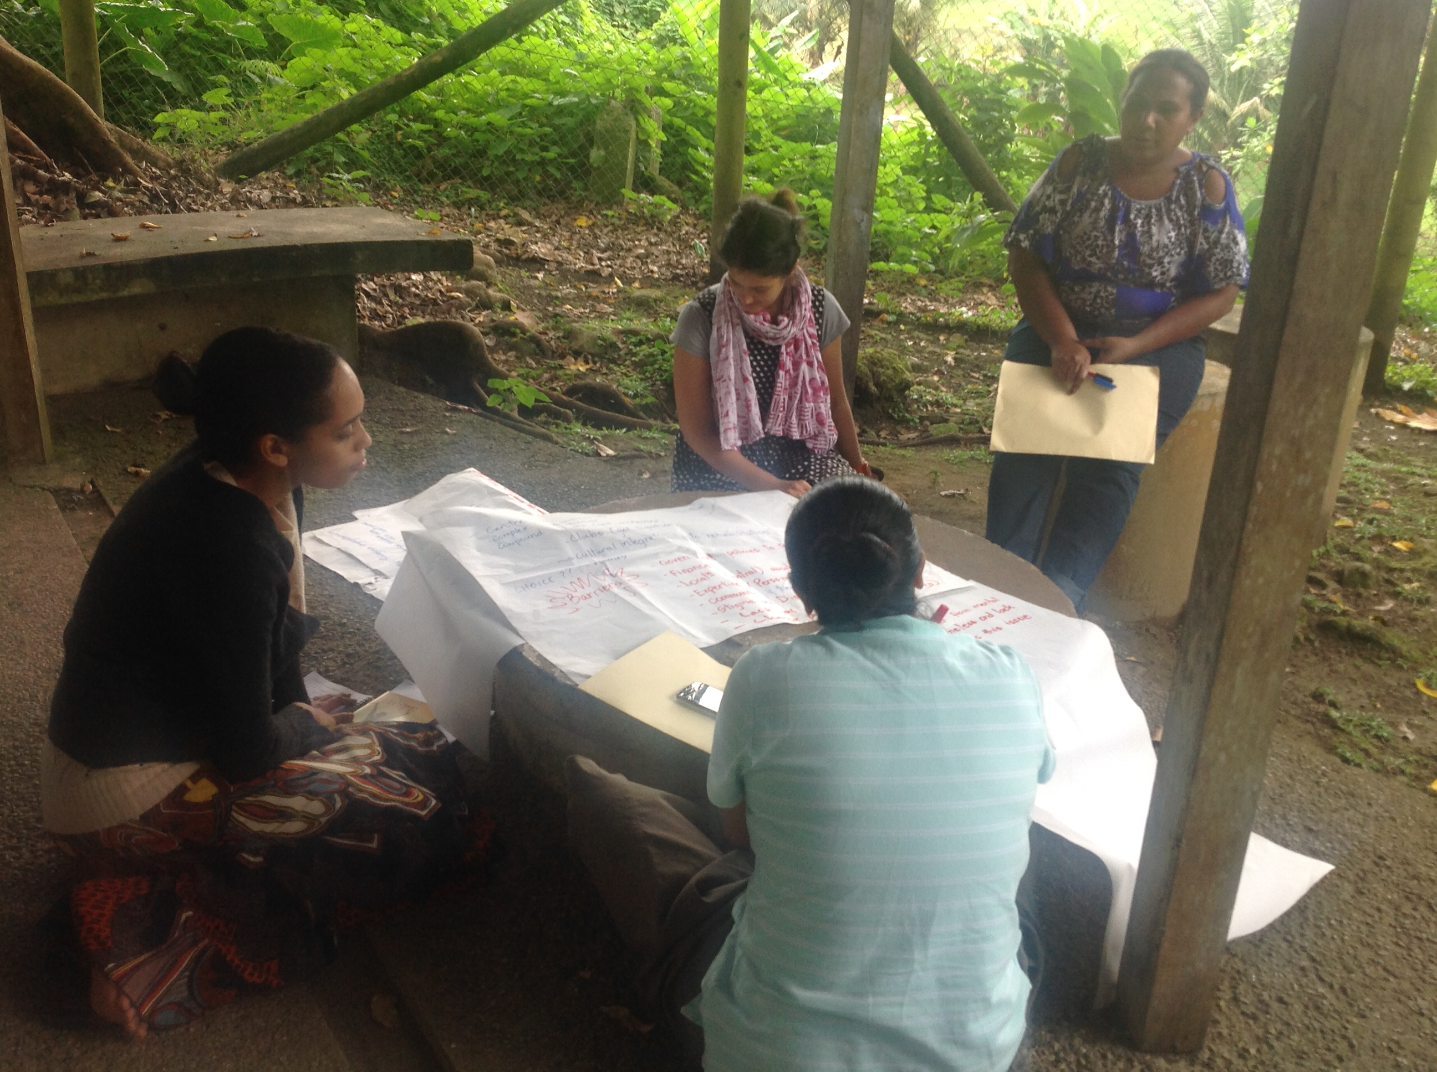
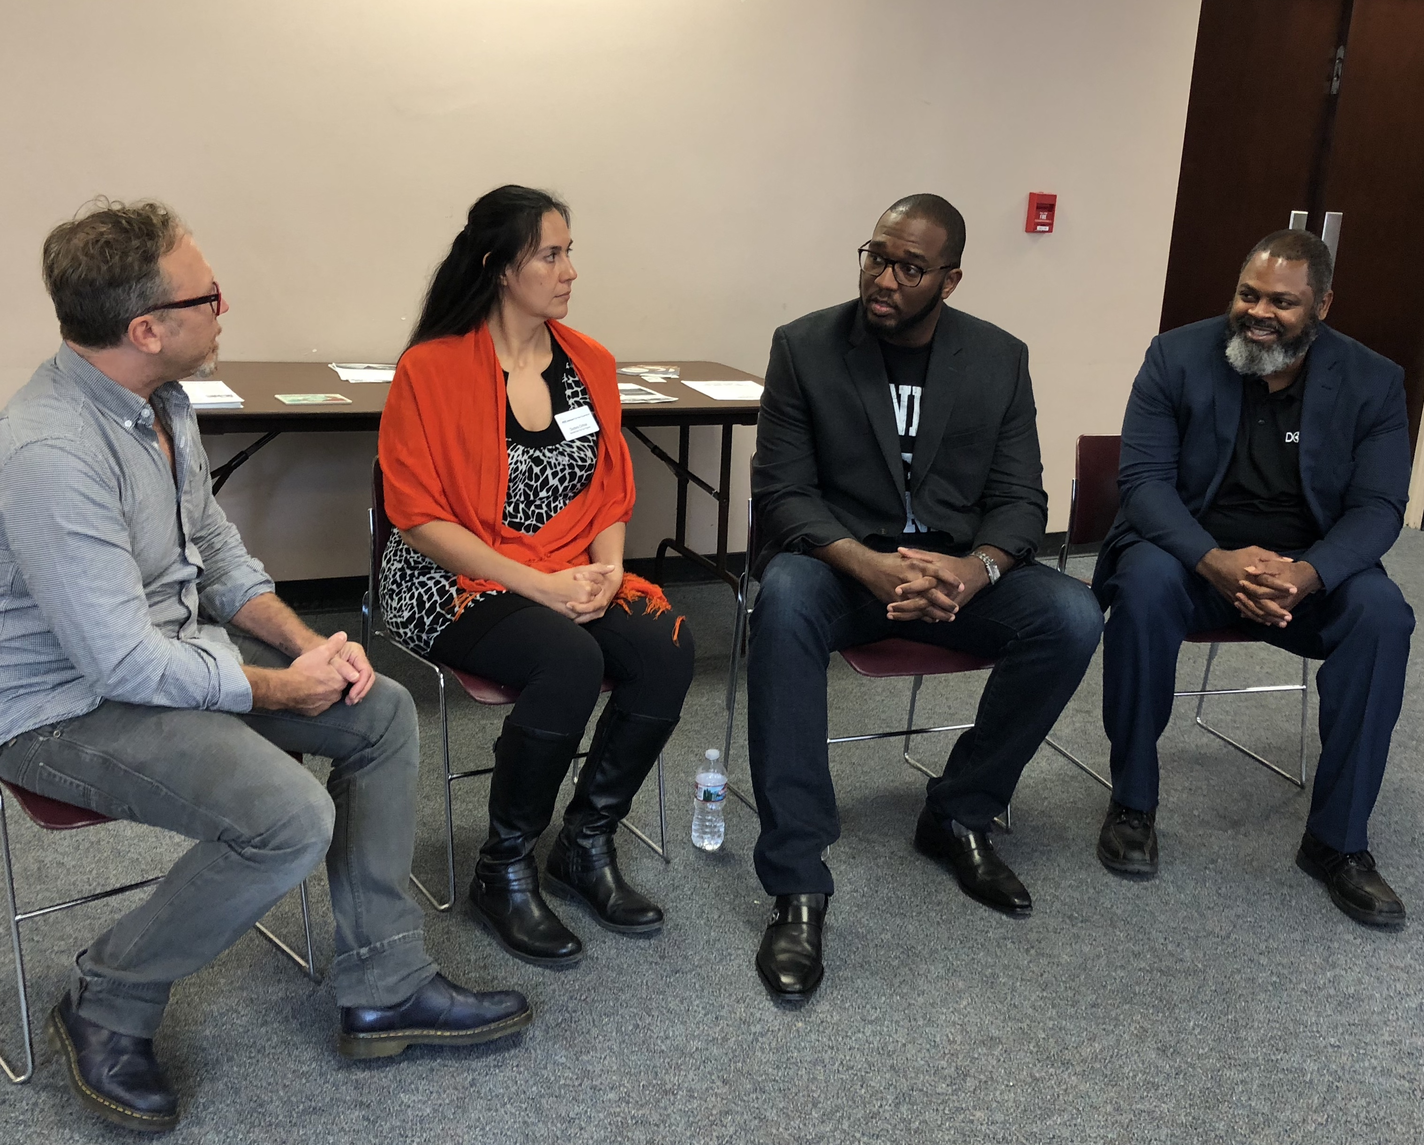
Why am I here?
Alignment with my personal mission and experience
15 +years Executive Management and Strategic Growth in non-profit, govt etc (CEO MHASF 2010-2016)
25+ years in mental health, social services, advocacy including homeless services outreach/shelters, etc.
Nationally/internationally active as leader/advocate/innovator health policy, programs, advocacy, research
TRAINING and mentorship of advocates
Social Project Innovation in the most challenging issues and places in the world

Slide 20
Lived experience. Lived Expertise.
Having an experience that is relevant to understanding, compassion and/or inspiration for others
Incorporating one’s lived experience in planning, programs, research or other ways

Slide 26
THE GOAL Of THE ACTIVATING HOPE PROCESS IS TO ACCELERATE THE MOVEMENT FROM INCLUSION TO INTEGRATION OF LIVED EXPERIENCE IN CRISIS CENTERS AND RELATED ORGANIZATIONS

Slide 32
ORGANIZATIONAL Readiness
Practices
Programs
Policies

Slide 34
0 1 2

Slide 35
0 1 2

Slide 37
Organizational Readiness for Change
Demonstration for systematic consideration of organizational readiness.
Worksheet #2

Slide 38
Part 3 – Activating Hope Process

Slide 39
Technical Assistance Process Pilot
Lifeline Crisis Centers eligible; Center Directors request/confirm with Team/Lifeline leadership
TA by remote and in-house
Approximately 5 centers; up to 20 hours./center (based on funding/availability)
July-December 2018 inclusive
Co-presentation with engaged Center leadership at CrisisCon or other industry conferences.

Slide 40
Technical Assistance Process
TA process:
Orientation and facilitated dialogue. Webinar content. Conference call and/or on-site meetings.
Individual LE engagement /disclosure process. Process tools, and materials for people exploring disclosure. Personal success planning.
Organizational self-assessment and planning. Structured judgment-free self-assessment of organizational lived experience integration. Strategic, realistic objective and successful timeline planning. HR and org culture change TA
PRACTICAL FOCUS ON CHANGING POLICIES, PROGRAMS, PRACTICES
Targeted training for staff and management. Customized short sessions on resources on problems associated with disclosure. Incorporating personal experience in support calls / peer support modality, LE research and empowerment.
Custom research/evaluation process based on above.

Slide 41
CHANGE IS ACTION After CONSIDERATION
ACTION TEAM Questions /considerations
How have we been doing to date?
How ready are we to challenge ourselves?
What kinds of change are we talking about?
What things do we wonder about?
Human resources issues
Proactive hiring for lived experience
“Arbitrary” exclusion from support services post-incident
How do we invite lived experience without tokenizing some / devaluing others?
Which of our inherited /habitual practices should we evaluate for change?
How should performance management change if at all?

Slide 42
Part 4 – Activating Hope: Early Adopter – Lines for Life

Slide 43
Activating Hope A partnership with Lines for Life Greg Borders, LCSW Crisis Lines Director, Lines for Life

Slide 44
How we got involved
Stephen Canova https://www.kptv.com/news/better_together/

Slide 45
How we chose our workgroup
All departments represented
Crisis Lines
Prevention & Education
Human Resources
Administration
Communications
Development
Board member involvement

Slide 46
Three Indicators Policy, Practice/Strategy, Programs
Policy
Guidelines of nondiscrimination and self-disclosure related to interviewing and hiring
Recruitment of people with lived experience affirmed in job announcements/ descriptions, etc.
Guidelines for sue of personal experience in public setting

Slide 47
Three Indicators Policy, Practice/Strategy, Programs
Practice Strategy
Evaluate current practices for volunteer eligibility

Slide 48
Three Indicators Policy, Practice/Strategy, Programs
Programs
Lived experience voice included in staff orientation, in-house trainings, etc
Training on how to use lived experience in support service is provided

Slide 49
Early Lessons Learned
Strong in practices, weaker in programs, and weakest in policy
Survey questions and participation

Slide 50
Questions?

Slide 51
www.activatinghope.com
Thank you for your time!
DeQuincy A Lezine, Ph.D.
drlezine@livedexp.academy
Eduardo Vega, MA
eduardo@redleverinnovations.com

