Slide 1

A data driven strategy for addressing frequent contacts to NYC Well
Presented by Sean Murphy, PhD and Anitha Iyer, PhD
10.19.18
Notes:
Thank you
Acknowledgment

Slide 2
Frequent Contacters
Notes:
Common problem
Past conversations:
CENTER: metrics, burnout
SYSTEM: “what proportion are frequent callers?”
Helplessness

Slide 3

What’s in a Name?
Frequent Callers
Repeat Callers
Familiar Callers
Known Callers
High Utilizers

Slide 4
Frequent Contacters…
Seek help regularly but do not always have an immediate crisis
Challenge the conventional crisis model of care
Take time to respond to.

Slide 5
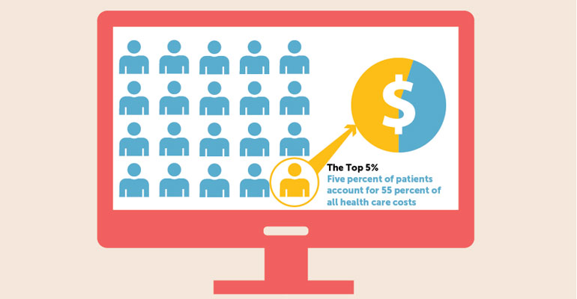

Slide 6
A few frequent contacters can account for a large proportion of calls.

Slide 7
3% of Callers 60% of Calls
Spittal et al. (2015)
1% of Callers 25% of Calls
Speer (1971)
14% of Callers 35% of Calls
Burgess et al. (2008)

Slide 8
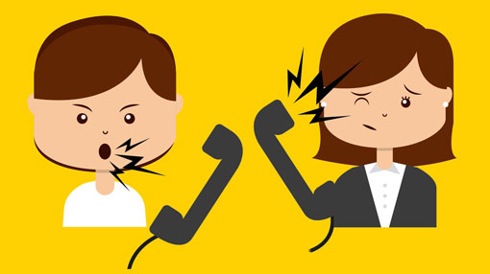

Slide 9


Slide 10


Slide 11
What to do?
Build empathy
Remind counselors that these individuals are reaching out to fill a gap in their care
Provide strategies for handling calls
And then…

Slide 12


Slide 13
Operational and Analytic Strategy
Call routing/diversion/management
Track
Report/Advocate
Collaborate/connect with the system

Slide 14
Identifying Frequent Contacters

Slide 15
Definitions of Caller Vary
Same phone number.
Identification by crisis center staff.
Call profile associated with the contact across several phone numbers / IP addresses.

Slide 16
Limitations of Only Using Phone Number
Excludes chat and other channels.
Does not accurately group individuals who may use several phone numbers, or IP addresses.
Does not distinguish service providers, or other numbers that may be frequently used.

Slide 17
Advantages of Using a Profile
Allows for multiple phone numbers, or IP addresses to be grouped under the same contact.
Helps to identify particular contacts, their contact patterns, and basic information.

Slide 18
Definitions of Frequent Vary
More than 1 call
More than 3 calls per month
More than 10 calls over several months
More than 20 calls per month
More than 1 call per day

Slide 19
What’s practical in terms of frequency?
More than 1 contact may be needed to coordinate service.
More frequent contacts may be needed over the course of one or more months to address a crisis.

Slide 20
What’s typical for NYC Well contacters?
79% make 1 contact in a month
13% make 2 contacts in a month
7% make 3-19 contacts in a month
~.2% make 20-49 contacts in a month
<.1% make 50+ contacts in a month

Slide 21
What’s typical for NYC Well contacts?
~35% of all contacts are made by someone who contacts us 1 time.
~11% by someone who contacts us 2 times.
~24% by someone who contacts us 3-19 times.
~10% by someone who contacts us 20-49 times.
~20% by someone who contacts us 50+ times.

Slide 22
NYC Well Frequent Contacter Definitions

Slide 23
NYC Well Definition of Contact
If a contact has been previously identified as a frequent caller by a counselor, associate that profile with other phone numbers / IP addresses used on the same day.
If there is no profile use the phone number if available.
If there is no phone number use the IP address.

Slide 24
NYC Well Definition of Frequent
Familiar Contacter: A contact who is not a service provider and who made 20 or more inbound contacts during a calendar month, across all phone numbers / IP addresses used.
Frequent Contacter: as above but for 50 or more inbound contacts during a calendar month.

Slide 25
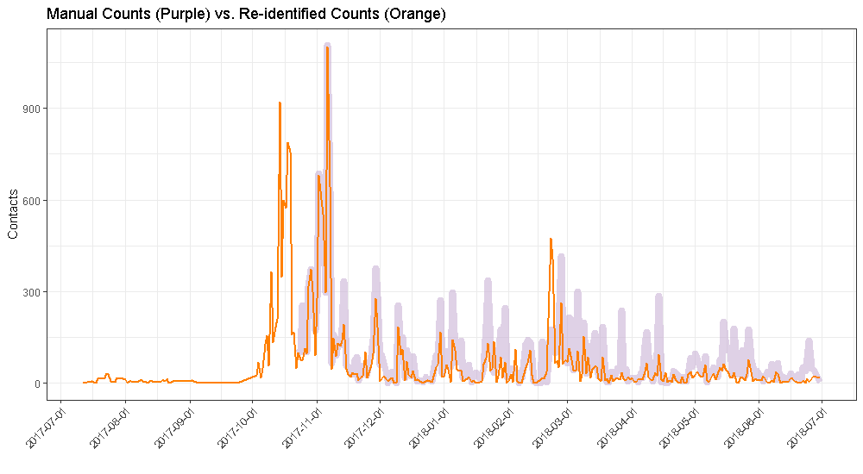
Validation: One Very Frequent Chatter

Slide 26
Before: Identification
7,335
Contacts

Slide 27
After: Identification
24,653
Contacts

Slide 28
Who Are Frequent Contacters?

Slide 29
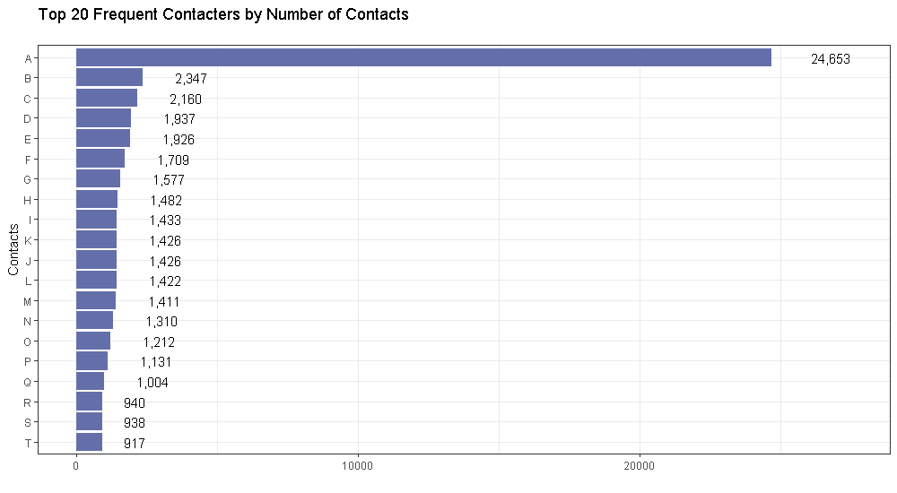
Top 20 Frequent Contacters

Slide 30
Characteristics of Frequent Contacts
Abandon and disconnect at higher rates.
Contacts tend to be shorter.
Slightly more likely to endorse: Stress, Anxiety, Relationship Problems and Difficulty with Sleep.
More likely to have had prior treatment.

Slide 31
Changing How We Look at Volume

Slide 32
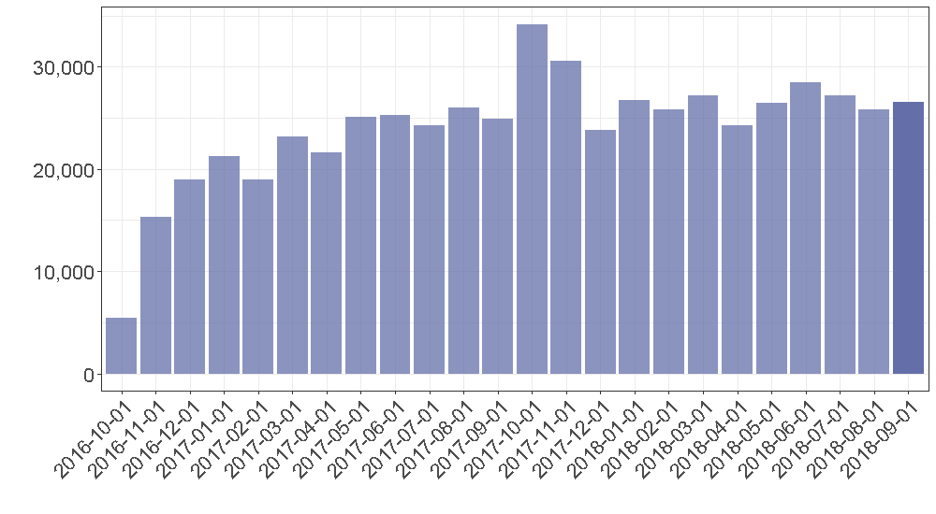
Before: View of Contact Volume

Slide 33
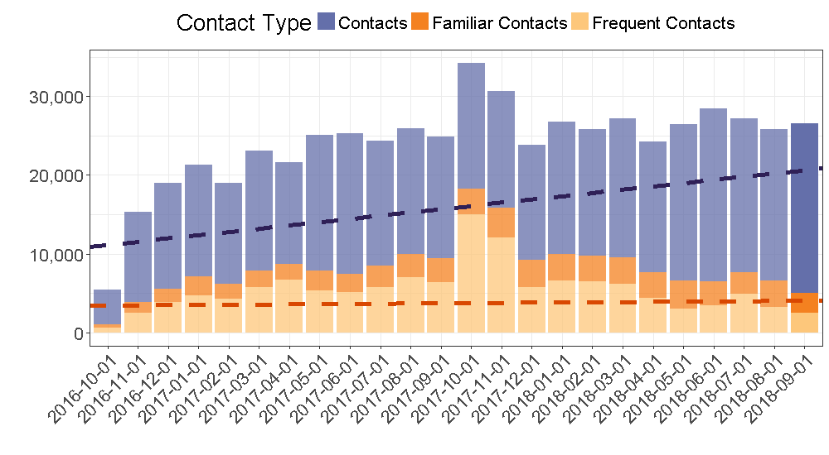
After: View of Contact Volume

Slide 34
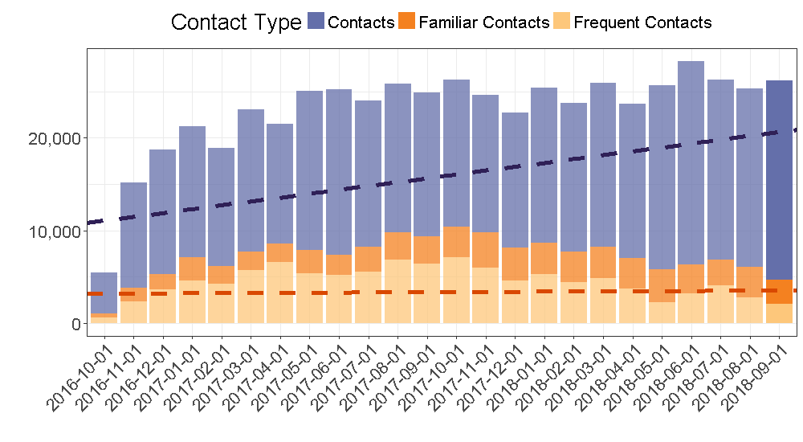
After: View w/ Frequent Chatter Removed

Slide 35
Volume with/without Frequent Chatter Removed

Slide 36
Value of Data-Driven Tracking and Reporting
Identify service gaps for high need individuals
Connect them to the right services
Report impact of service on high need individuals AND on the general public
KNOW YOUR VALUE
Validate staff experience and provide management activities
Plan better.

Slide 37
We Recommend…
Don’t be afraid of data
Make it work for you
Connect IT and clinical/program teams
Collaborate and problem-solve

Slide 38
Questions?

Slide 39

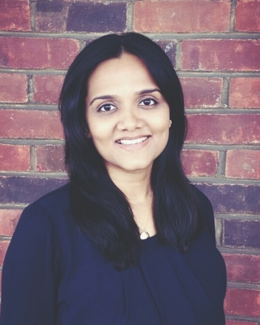
Sean Murphy, PhD
Research and Analytics Consultant
Vibrant Emotional Health
smurphy@vibrant.org
Anitha Iyer, PhD
Chief Clinical Officer
Vice President, Crisis and Behavioral Health Technologies
Vibrant Emotional Health
aiyer@vibrant.org
39

